Slide 1
Why Finding Atlantic Shipping Records is Challenging
North American Atlantic Ship Records Prior to 1914
Notes:
Created February 2020
Revised May 2023

Slide 2
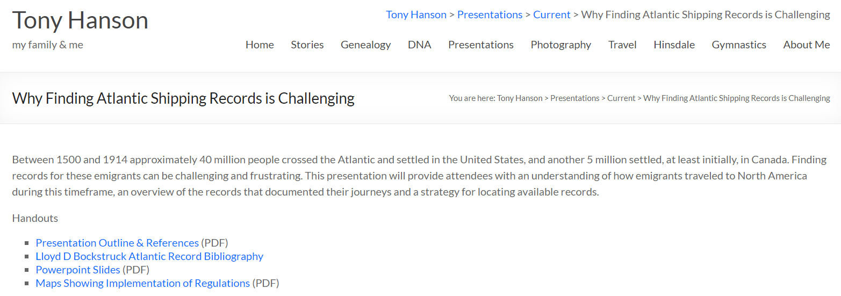
http://rayson.us/aehanson
Presentations -> Current
Why Finding Atlantic Shipping Records is Challenging

Slide 3
Why Finding Atlantic Shipping Records is Challenging
North American Atlantic Ship Records Prior to 1914
Notes:
Created February 2020
Revised May 2023

Slide 4
Why is it so difficult to find their shipping records?
45 Million Immigrants entered Canada & The Unites States between 1500 and 1914
Most of them crossed the North Atlantic and arrived by ship
In 2010, 72.4% of the US population was of European decent
Notes:
https://en.wikipedia.org/wiki/Americans - 2010 estimate

Slide 5
Agenda
How did they travel?
Why did they come?
Regulations & Records
Transmigration
Online Resources
Search Strategies

Slide 6
Terminology
Emigration – Leaving a country and settling somewhere else
Transmigration – Passing through a country while emigrating
Immigration – Entering a country and settling there

Slide 7
How did they travel?

Slide 8
Atlantic Crossings by Sail
This was the only option until the mid 1800’s
A normal, uneventful trip took 7 – 8 weeks
It could be done in 4 weeks
It sometimes too as long as 12 weeks
Schedules were unreliable
Emigrants congregated at the point of departure waiting for their ship
The entire trip could take 2 – 5 months
Notes:
Passengers sailed from ports where ships from the new world arrived.
Most Irish emigrants sailed from England because few ships sailed from Ireland to the United States.

Slide 9
Eating During the Voyage
Early passengers were required to bring enough food and water to feed themselves for 6 weeks.
From about 1850 ships from Bremen and Hamburg provided meals for all passengers
By 1873 all ships furnished food
But steerage passenger still had to provide their own utensils and bedding
Notes:
The Transportation of Immigrants and Reception Arrangements in the Nineteenth Century - Thomas W. Page

Slide 10
Emigrants Were Another Type of Cargo
Ships brought goods and cargo to Europe
Lumber, Furs, Dried Fish, Whale Oil, Iron, Gunpowder, Rice, Tobacco, Indigo
Europe sent manufactured goods, textiles, furniture, luxuries
Carrying Emigrants provided an additional source of income
The ships were designed to carry cargo – not people
People went where the cargo was being shipped
Notes:
People began to congregate at ports waiting for ships to arrive

Slide 11
Atlantic Crossings: Steam Ships
Steam powered ships emerged in the 1850’s
Sailing ships continued to sail during this transition period
1865 – 1st year more people traveled on steamships than sailing ships
Steam effectively took over by 1880
Regular schedules were established
Crossing times reduced to 1 week by 1914
Notes:
1865 – the first year that more people were transported on steam ships than sailing ships.

Slide 12
Atlantic Crossings: Steam Trains
Use of Steam powered trains also expanded greatly during this period.
Made it easier to travel to the port departure
Enabled development of integrated train/ship routes and schedules
Made it easier to travel from the point of arrival to more distant destination

Slide 13
Why did they come?
Food Shortage
To escape oppression
Economic Opportunity
Cheap/free land
Slavery

Slide 14
3 Waves of Migration
1st: Prior to 1820
2nd: 1820 – 1890
3rd: 1890 – 1920’s

Slide 15
Prior to 1820: The 1st Wave
Organized Migration
Several European Powers established outposts in the new colony
Notes:
This group did not just wake up one morning and decide to go to North America

Slide 16
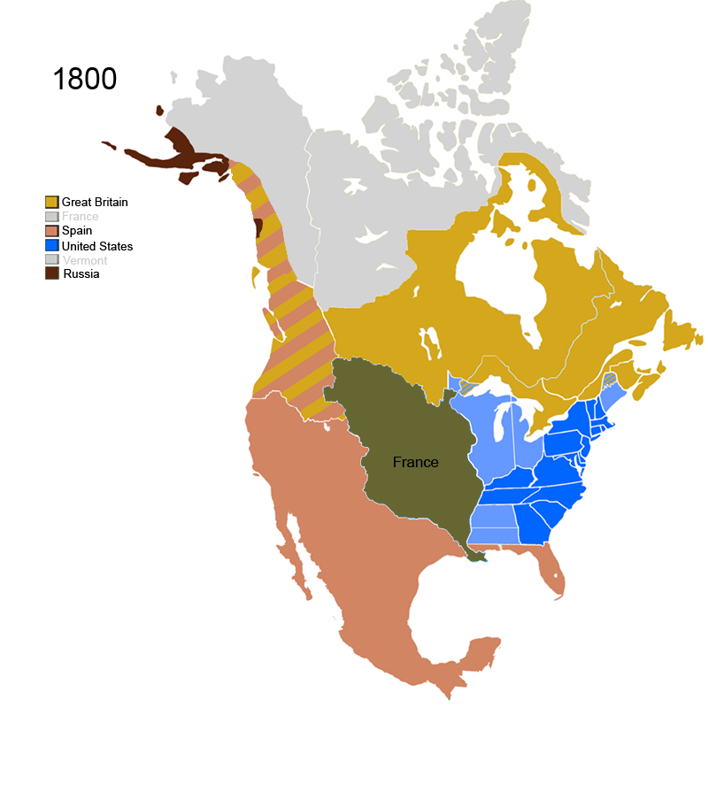
Russia
Great Britain
Spain
Map Source:
Wikipedia - Territorial evolution of North America since 1763
Notes:
https://en.wikipedia.org/wiki/Territorial_evolution_of_North_America_since_1763#1819
Philadelphia began to keep records of passengers who had to pay import duties for excess baggage in 1800

Slide 17
Prior to 1820: The 1st Wave
Organized Migration
Several European Powers established outposts in the new colony
There was a shortage of labor
Rotterdam (The Netherlands) and Antwerp (Belgium) were major ports of departure
Many boats brought freight into these ports & had capacity to carry people on the return trip
Emigrants could travel there by boat (Rhine/Meuse river)
Notes:
This group did not just wake up one morning and decide to go to North America

Slide 18
Protestants from northwestern Europe
Approximately 1.2 Million people arrived in this period
Soldiers
Religious missionaries
Settlers recruited for chartered colonies
Indentured servants
Exiles
Convicted laborers
Slaves

Slide 19
Slaves
Brought into Virginia as early as 1619
Most arrived before 1780
It is estimated that 800,000 were in the US by 1808 (when the importation of slaves into the United States was banned)
In 1820 slaves represented 16% of the United States population

Slide 20
Major Port
Philadelphia
Popular port of arrival for immigrants settling East of the Alleghenies
Agricultural Germans and Scotch-Irish settlers
Notes:
Germans via Rotterdam and Antwerp
New Orlans – La Purchase - 1803

Slide 21
1820 – 1890: The 2nd Wave
Autonomous Migration
Rapid industrialization provided opportunities for migrants of modest means and/or skills
European barriers to emigrating (such as serfdom) were removed
Military conscription and ethnic discrimination prompted mass migration out of Eastern Europe
Government policies encouraged/facilitated transatlantic relocation
Advances in transportation (steamships and railway networks) made travel easer, more reliable and more economical
Notes:
1820 is a key date to remember….
Recovery in the US from the industrial depression of 1819 – 1820
1849 – 1849: European Revolutions. Tens of Thousands killed, many more were forced into exile.

Slide 22
Major Ports
New York
Provided better transportations options to Buffalo, Cleveland and Milwaukee
New Orleans
Longer voyage (2 – 3 weeks longer)
Ships were inferior
Travel up the Mississippi was unpleasant & dangerous.
Notes:
Germans via Rotterdam and Antwerp
New Orlans – La Purchase – 1803
1861 – 1865 – US Civil War, slowed down emigration, blockade of Southern Ports

Slide 23
15 Million people arrived during this period
Countries of Origin
Irish (Potato Famine - 1847)
German (failure of the democratic revolutions of 1848)
Scandinavians
(Chinese)
Vast majority of the US arrivals were processed in New York City
Castle Garden established in 1855
Notes:
Jews began to leave Germany in large numbers in 1840. Some 250,000 immigrated to the US by the outbreak of WWI (July 28 1914).
1861 – 1865: US Civil War slowed things down
Chinese Immigrants (77% lived in California)
1851 – 1860 (Gold Rush) - ~40,000
1863 – 1869 (Construction of the railroad across the US) - ~ 64,000
1881 – 1890 ~62,000

Slide 24
1890 – 1920’s: The 3rd Wave
Approximately 22.3 Million people
From Southern and Eastern Europe (Italy, Russia, Austro-Hungary)
75% came through New York
Emigration was severely restricted at the outset of WWI (1914)
Notes:
The value of transporting people was recognized, and ships were developed for this exclusive purpose beginning in the mid 1850’s.

Slide 25
Regulations & Records

Slide 26
Prior to 1820
No records or documentation were required for immigrants arriving by ship in the United States
Notes:
Philadelphia was the major port of entry

Slide 27
Until
Philadelphia
Map Source:
Wikipedia - Territorial evolution of North America since 1763
Notes:
https://en.wikipedia.org/wiki/Territorial_evolution_of_North_America_since_1763#1819
Philadelphia began to keep records of passengers who had to pay import duties for excess baggage in 1800

Slide 28
The Steerage Act of 1819
a.k.a. the Manifest of Immigrants Act
Intended to provide statistical information about immigrants
Took effect in 1820
Customs Passenger Lists were submitted to U.S. Customs on arrival
Contained limited information about the passengers

Slide 29
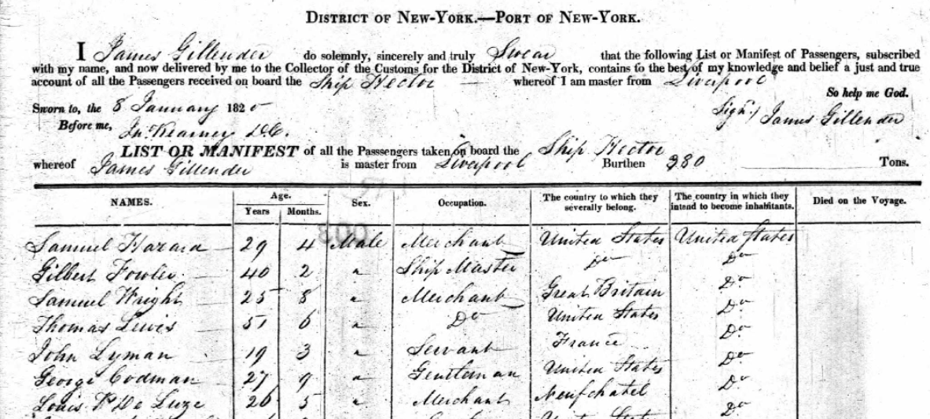
1820 United States Record
Notes:
January 8, 1820 – Port of New York

Slide 30
The Steerage Act of 1819
Only applied to ships arriving at United States ports
Canada did not (yet) have similar requirements

Slide 31
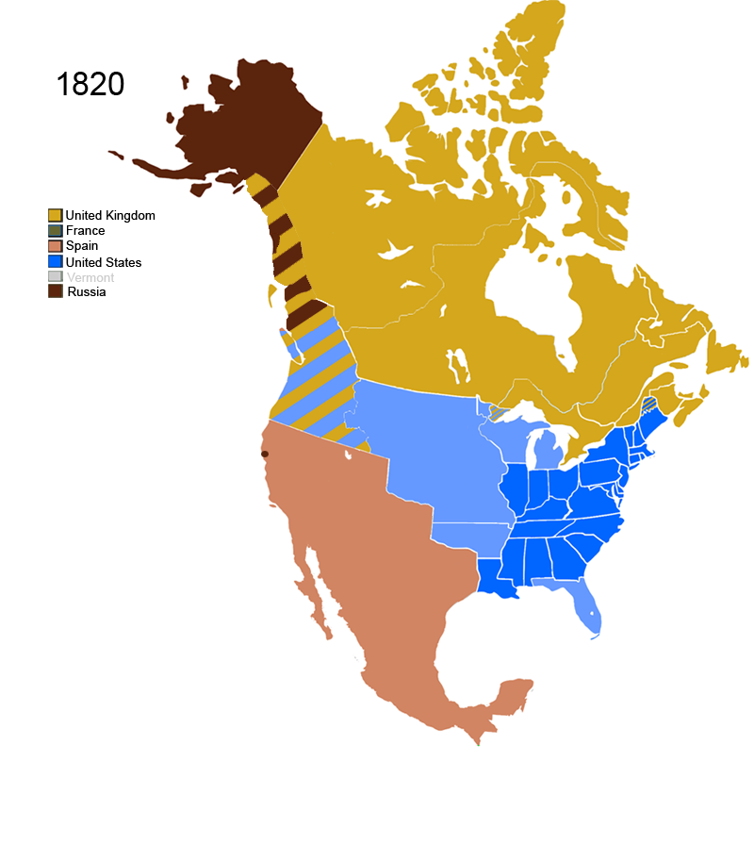
Map Source:
Wikipedia - Territorial evolution of North America since 1763
Notes:
Louisiana Purchase occurred in 1803
Major Ports: New York, Boston, Philadelphia, Baltimore and New Orleans

Slide 32
Additional Laws, Regulations and Events
1825:
Erie Canal opened (connecting the Hudson River to Lake Erie).
New York surpassed Philadelphia as the busiest US port of entry.
1849:
Changes in British law made Canadian ports much more desirable for shipping companies

Slide 33
Additional Laws, Regulations and Events
1865: Canada began documenting immigrants (similar to US records)
Canadian Ports of entry:
Quebec and Montreal (Summer when the St. Laurence River was ice-free)
St. John and Halifax (Winter)
Schedule A – Particulars Relative to the Vessel
Port of Embarkation (Departure)
Name
Age
Profession
County of Birth
Destination Port
Notes:
The US Started recording this information in 1820….

Slide 34
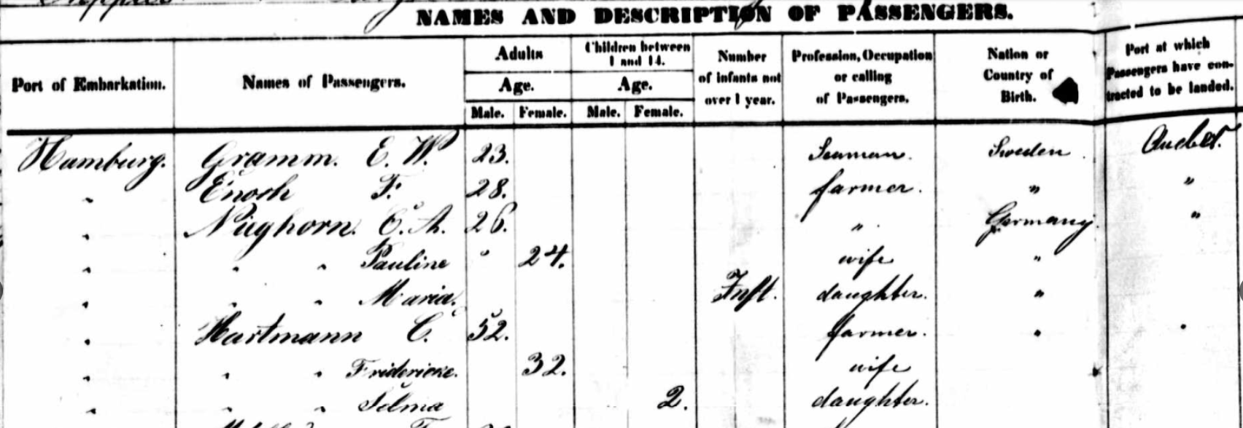
1865 Canadian Record

Slide 35
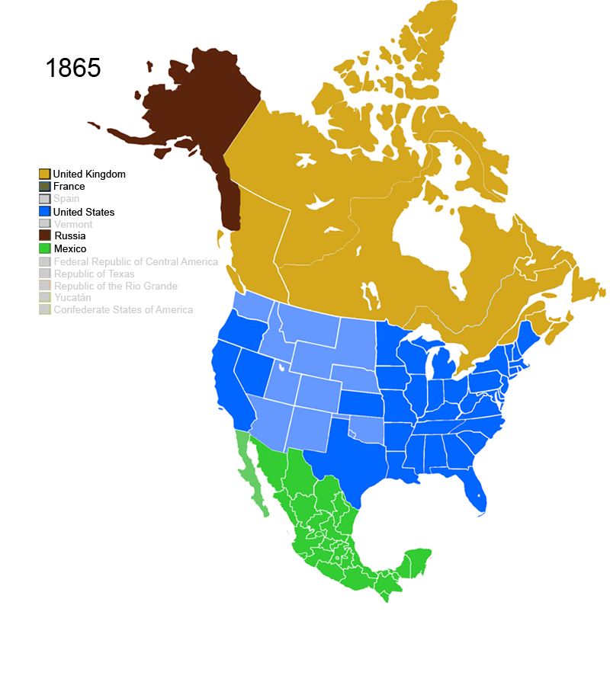
Canadian Rules
US Rules
Map Source:
Wikipedia - Territorial evolution of North America since 1763

Slide 36
Additional Laws, Regulations and Events
1890’s – Control of immigration was passed to the Immigration and Naturalization Service (INS).
Immigration Manifest Forms were required beginning in 1891.
Contained substantial information about passengers

Slide 37
Additional Laws, Regulations and Events
1891: Inspection and deportation of emigrants begins in the US
The 1st Immigration Inspection Station established at the US – Canadian border
1892: Ellis Island opened
1893: Immigration Manifest Forms were standardized
Additional information was required (5 -> 21 columns)
1903 – Race was added
1906 – Six more items were added (personal description, place of birth)
1907 – Name and address of nearest living relative was added
Notes:
Federal Government created immigrant receiving stations at all port of entry. Steamship companies were now required to transport anybody rejected for entry back to their port of departure.

Slide 38
US Compliance for Canadian Ports of Entry
1895:
US laws and rules were applied to all US-bound passengers
The US placed Immigration Service agents at Canadian seaports to collect the manifests and inspect US-bound passengers
Tickets for transportation to the US were only provided to those who appeared to be admissible under US law
Notes:
1898 - Ellis Island replaced Castle Garden

Slide 39
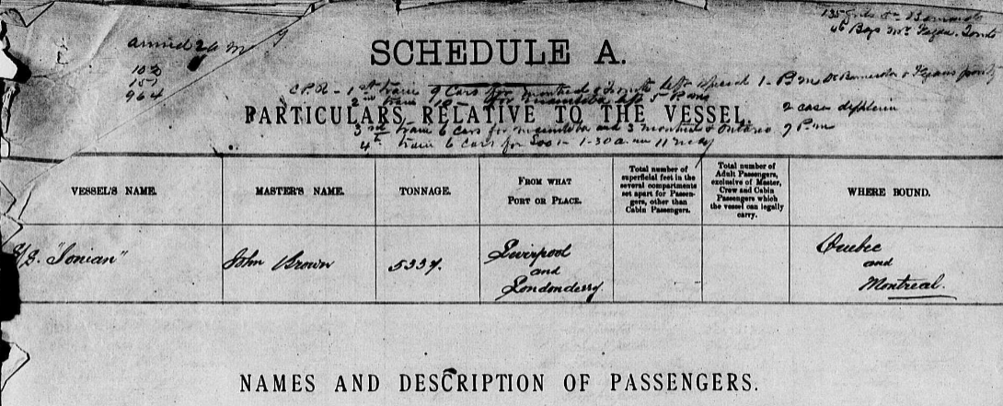
SS Ionian, Sailed from Liverpool to Quebec, arriving 30 April 1903
Canadian Manifest

Slide 40
SS Ionian, Sailed from Liverpool to Quebec, arriving 30 April 1903
United States Manifest

Slide 41
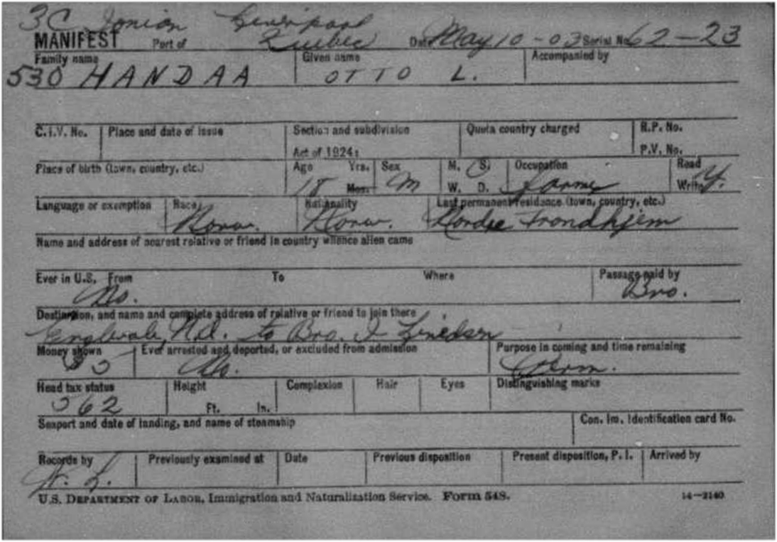

Slide 42
SS Ionian, Sailed from Liverpool to Quebec, arriving 30 April 1903
Canadian Manifest
Notes:
Notes about the four Canadian Pacific trains scheduled to carry passengers to their final destinations.

Slide 43
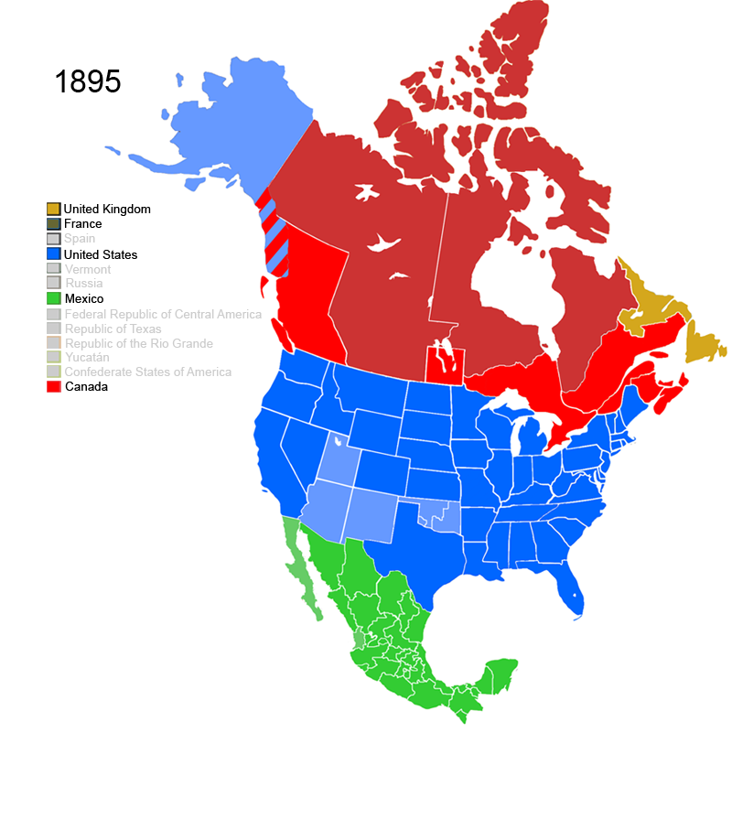
Canadian Rules
US Rules
US Rules
Map Source:
Wikipedia - Territorial evolution of North America since 1763
Notes:
US imposed restrictions on US bound ship passengers

Slide 44
US Compliance for Canadian Ports of Entry
1906:
Canada began to document immigration of Canadians to the US
Prior to this documentation was only required for those born outside of Canada
US Began documenting immigrants from Mexico
Card Manifest was created for each person
Recorded the same information as the ship manifest

Slide 45
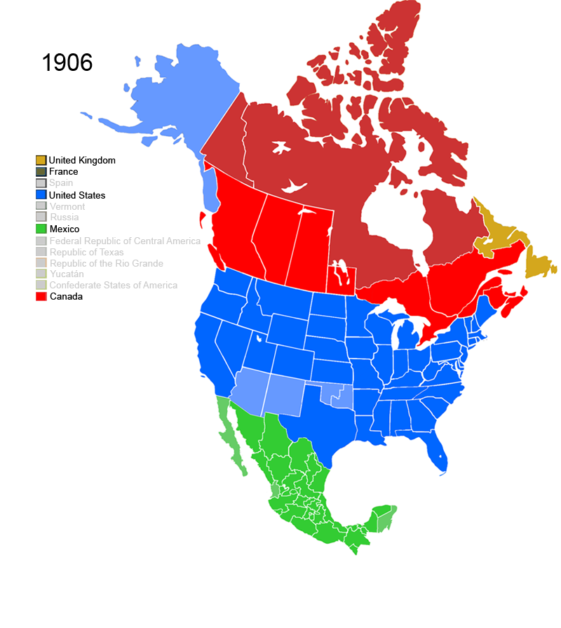
Map Source:
Wikipedia - Territorial evolution of North America since 1763

Slide 46
Search Strategy

Slide 47
Begin by Researching the Basics
Name
Birth
Marriage
Death
Parents
Siblings
Spouse
Occupation
Children
Burial

Slide 48
Additional Immigration Facts (or Rumors!)
Reason for immigration
Port of Departure
Name of the ship
Traveling companions
Route Traveled
Port of Arrival
Date of Arrival
Age on arrival
Final Destination

Slide 49
Sources of Emigration Information
US Census
1900, 1910, 1920 or 1930 recorded year of entry and citizenship status
Naturalization Applications
Local histories
Personal and family documentation
Oral family traditions
Church records
Homestead application (act of 1862)
Notes:
Homestead act was passed in 1862

Slide 50
Basic Information Required For Online Searching
Full Original Name
Recorded at the point of embarkation
Age at Arrival
Date of Arrival
Notes:
Manifests and other shipping documents sometimes record other information but not always
Indexing may have only been done on these fields.
Knowing where your immigrant ancestor arrived really help

Slide 51
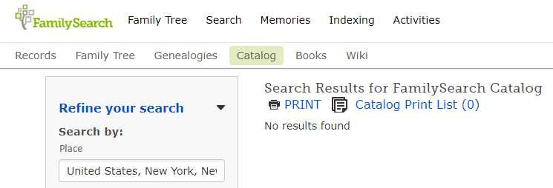
Family Search Card Catalog

Slide 52
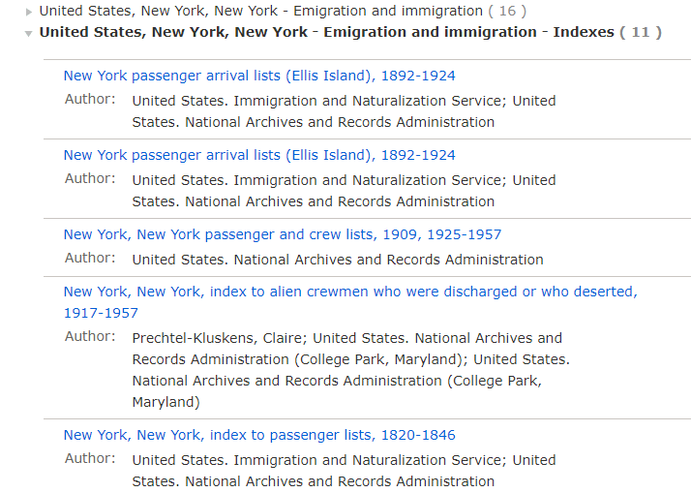

Slide 53
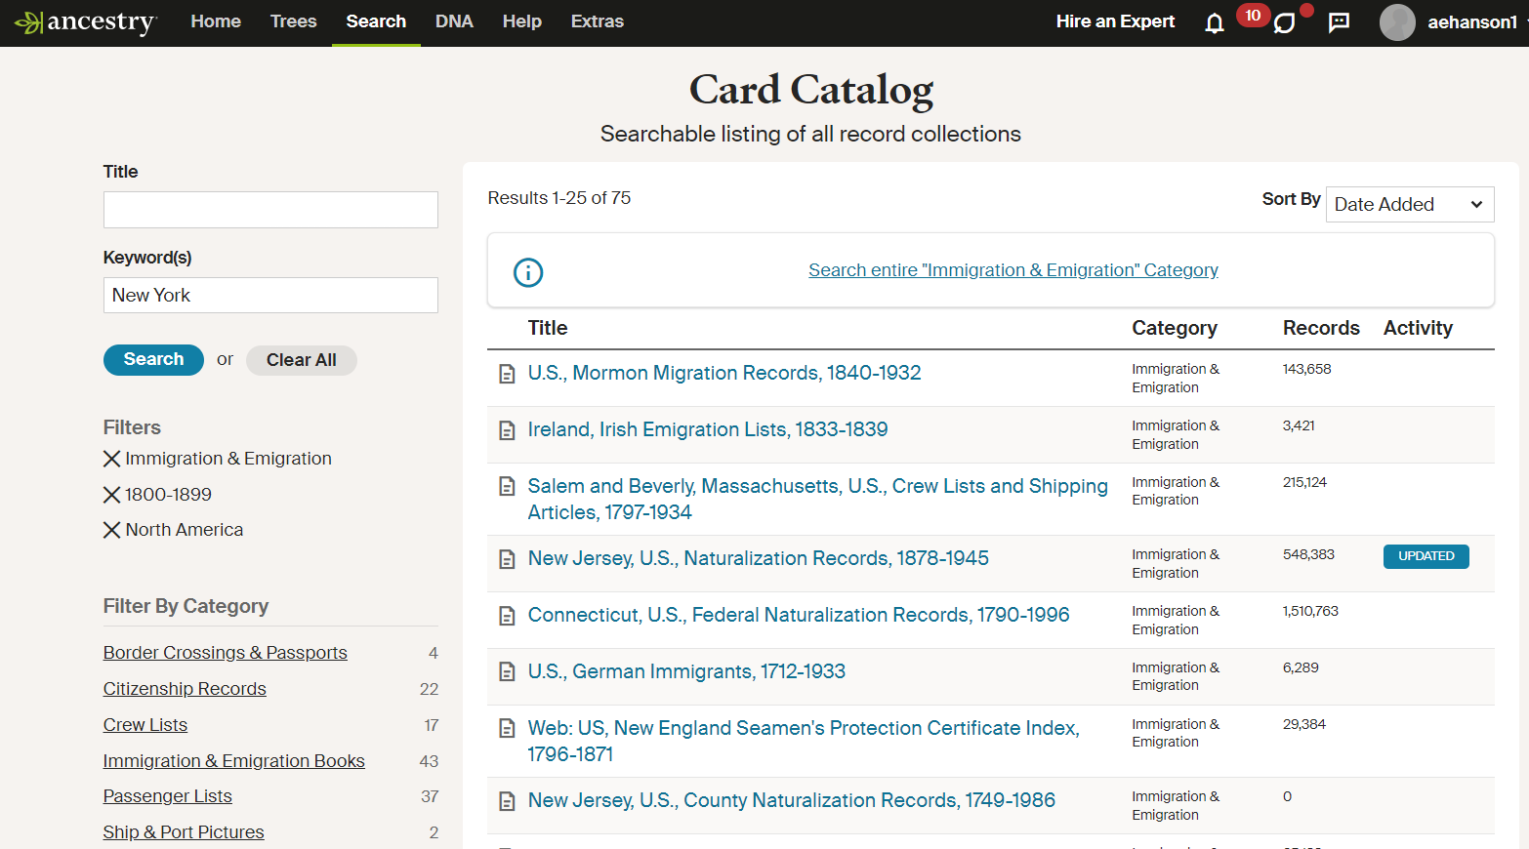
Notes:
Filter by Category, Location and/or Date Range

Slide 54
https://www.germanroots.com/
Notes:
https://www.familysearch.org/search/image/index?owc=https://www.familysearch.org/service/cds/recapi/collections/2185163/waypoints

Slide 55
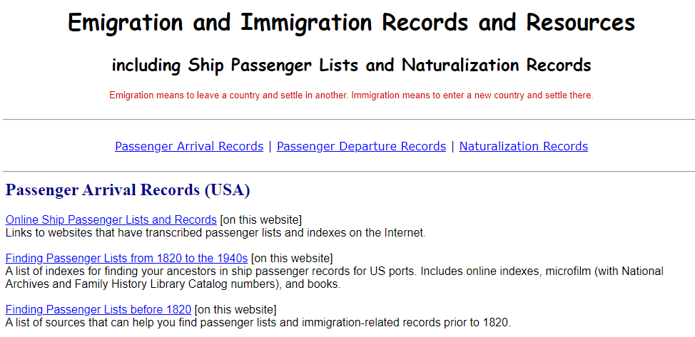

Slide 56
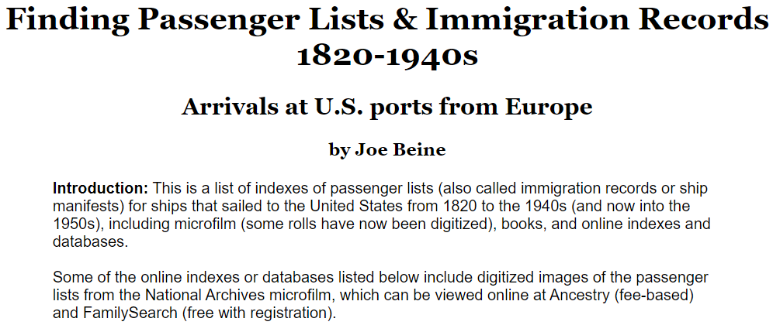
https://www.germanroots.com/

Slide 57
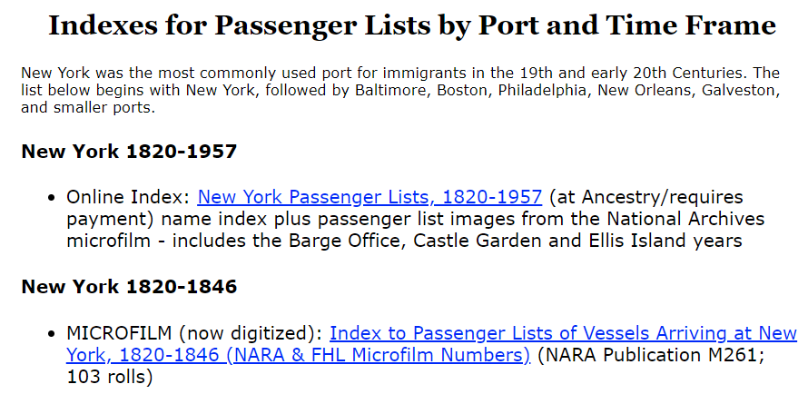
https://www.germanroots.com/

Slide 58
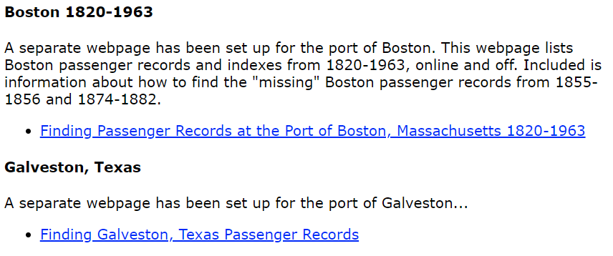
https://www.germanroots.com/

Slide 60
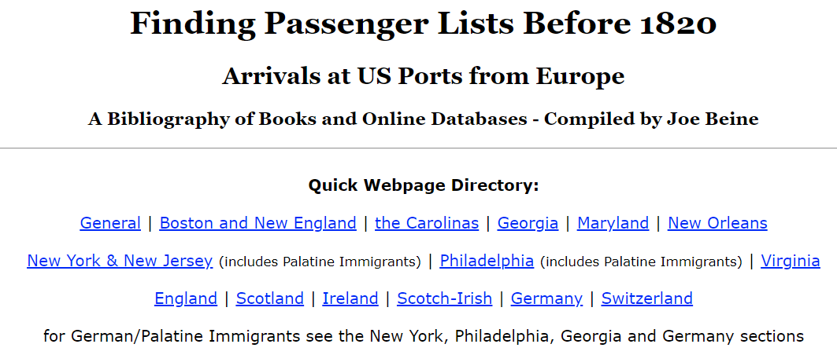
https://www.germanroots.com/

Slide 61
https://www.germanroots.com/

Slide 62
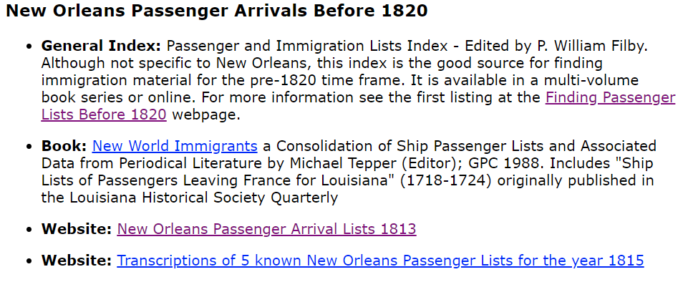
https://www.germanroots.com/

Slide 63
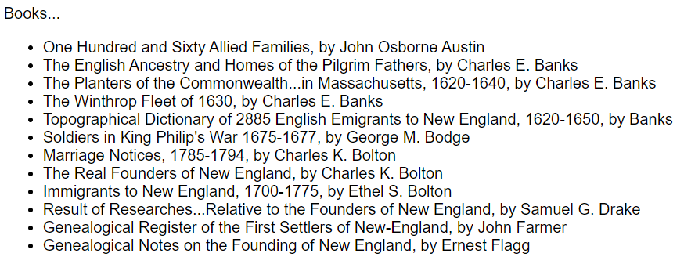
https://www.germanroots.com/

Slide 64
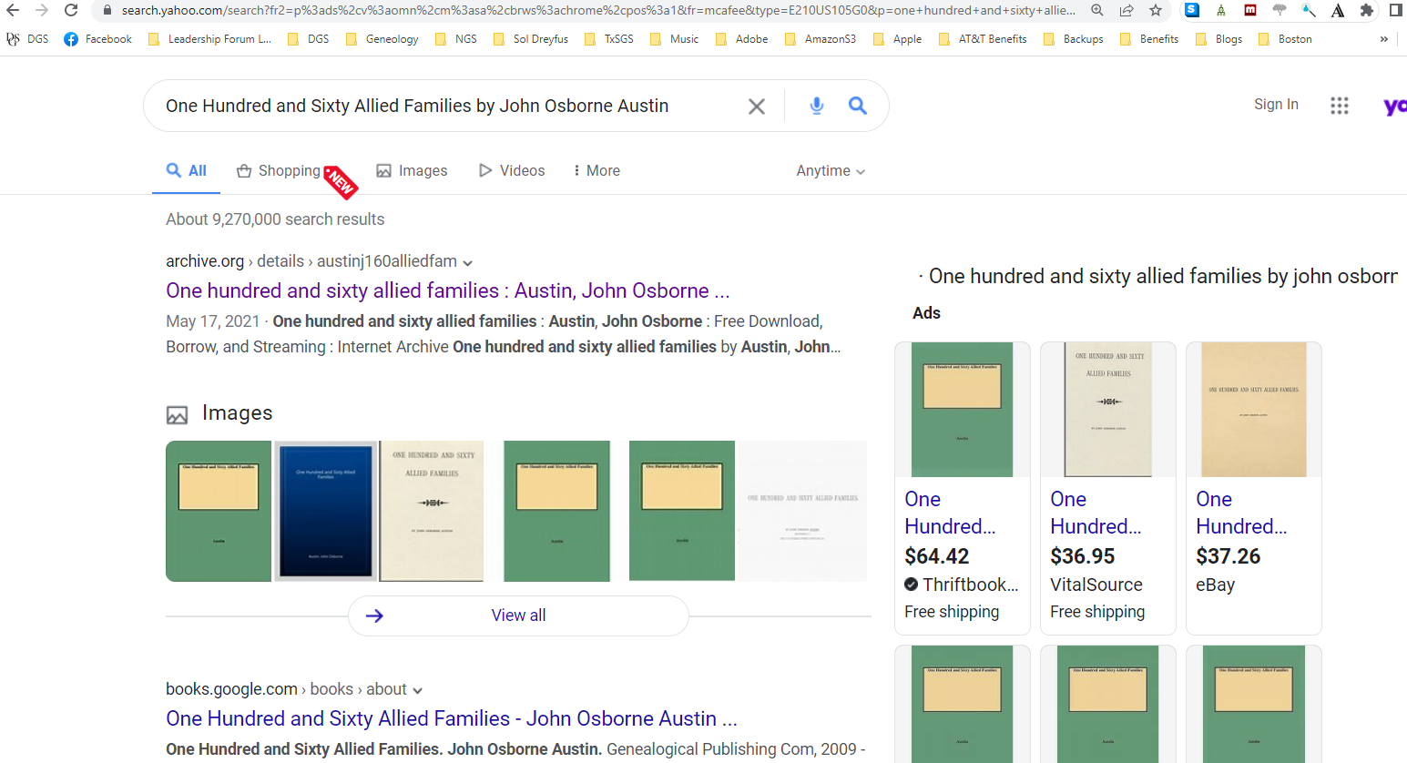

Slide 65
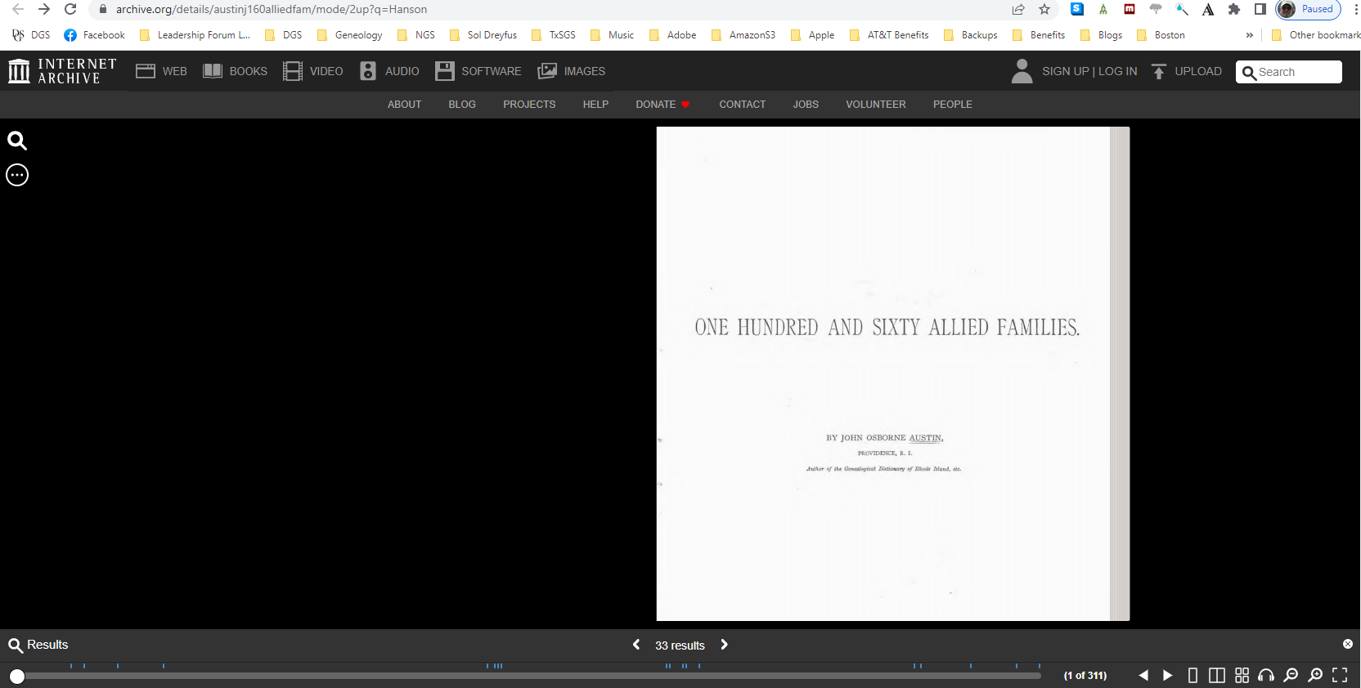

Slide 66
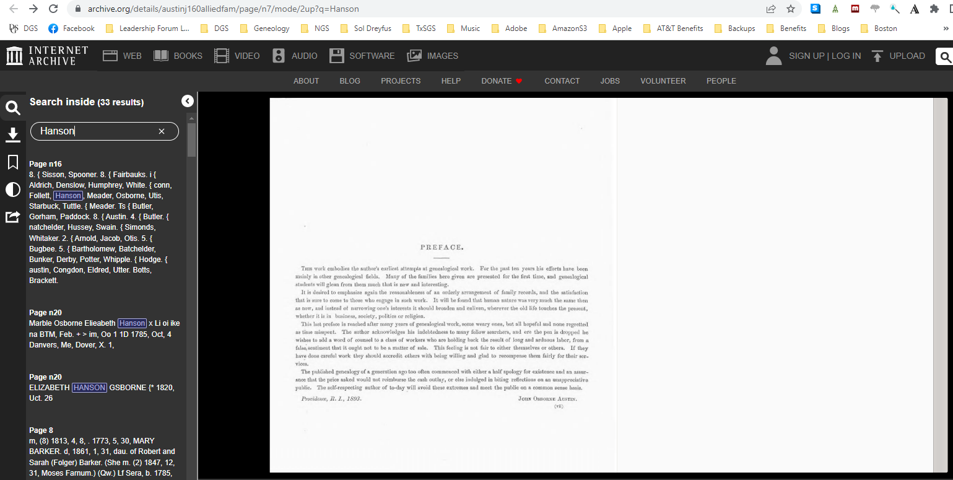

Slide 67
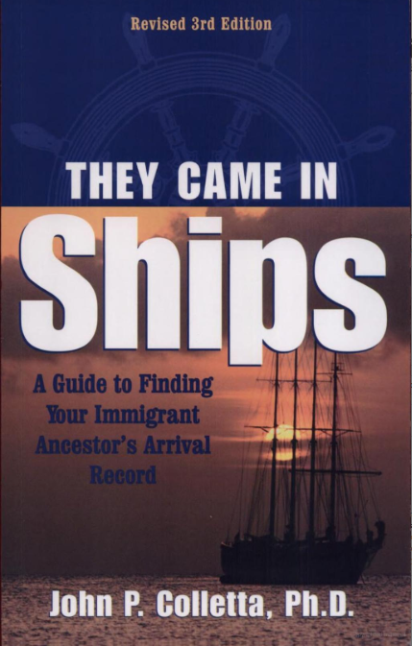
23-page Bibliography
Search Strategies
Notes:
Last revised in 2008
Bibliography: pages 135 - 158
https://books.google.com/books?id=thortsX3HVoC&printsec=frontcover&source=gbs_ge_summary_r&cad=0#v=onepage&q&f=false

Slide 68
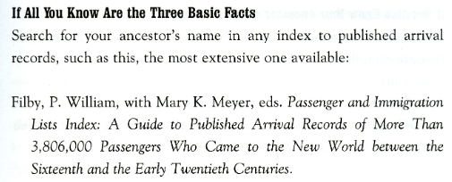
They Came in Ships: A Guide to Finding Your Immigrant Ancestor's Arrival Record
John Philip Colletta
3rd Edition – Page 25
Notes:
Name, Date of Arrival, Age on Arrival

Slide 69
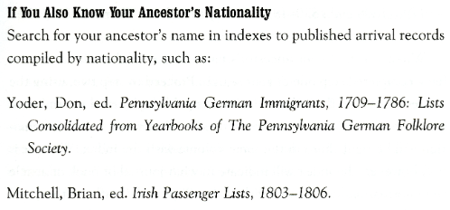
They Came in Ships: A Guide to Finding Your Immigrant Ancestor's Arrival Record
John Philip Colletta
3rd Edition – Page 25

Slide 70
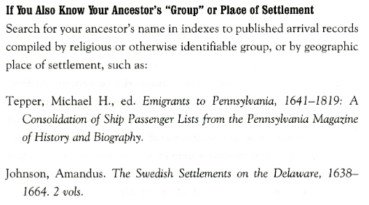
They Came in Ships: A Guide to Finding Your Immigrant Ancestor's Arrival Record
John Philip Colletta
3rd Edition – Page 25

Slide 71
Immigrants Ships Transcribers Guild
https://immigrantships.net

Slide 72
This was 18,000 in 2020….
https://immigrantships.net
Notes:
They went from 18,000 Passenger manifests in 2020 to 26,000 Passenger manifests in 2023!

Slide 73
It!
Google searches sometimes produce useful results
Try searching for variations of the name
If you know where they came from, try searching for the town name

Slide 74
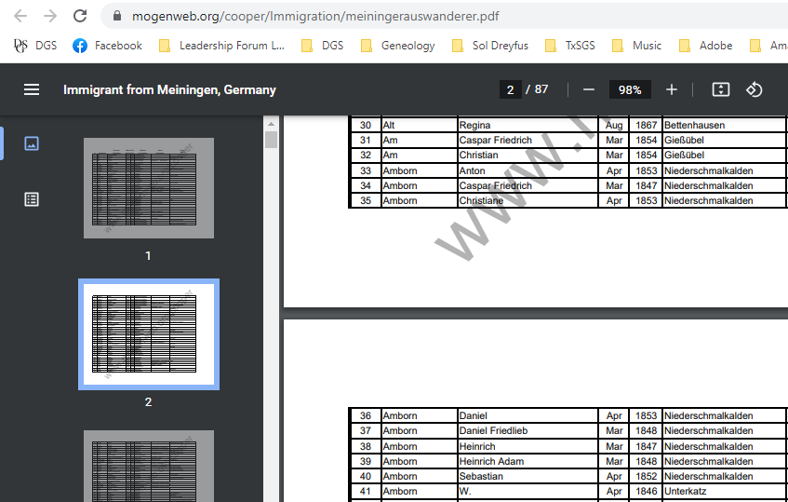
Notes:
The Amborn family has been traced to Niederschmalkalden, Sachsen-Meiningen, in the modern-day state of Thüringen, Germany thanks to the efforts of members of the Cooper County, Missouri Historical Society. They have transcribed newspaper and passport information from the period and have created a database of Immigrants from Sachsen-Meiningen, Germany (among other areas). This database (viewable on the societies website) refers to several members of the Amborn family and identifies the month & year that they departed Germany for the United States.

Slide 75
Transmigration
Immigrants did not always sail directly from their native country
Many traveled to Rotterdam, Antwerp, Le Havre, Bremen and Hamburg from other countries
Many entered the United Stated via Canada
Sometimes it was the least expensive route
Some chose that route to avoid US regulations
Many European emigrants passed through England on their way to North America

Slide 76
Transmigration
England dominated the Atlantic route (because of the number of British and Irish immigrants)
More ships
Better Service
Lower cost
This dominance grew as they established feeder routes to England from the rest of Europe

Slide 77
Hull, England
The largest transmigration port in England
Between 1836 and 1915 about 2.2 Million emigrants from Denmark, Finland, Germany, Norway, Russia and Sweden passed through Hull
They would remain on their ships until their train was ready
Then they would travel directly to Liverpool, Glasgow, London or Southampton and immediately board their ship
The train station was usually immediately adjacent to the boat dock
Grimsby was also a major transmigration port

Slide 78
Notes:
How it appeared in 2019

Slide 79
Notes:
How it appeared in 2019

Slide 80
They All Sailed From England or Scotland
Regardless of their county of origin
Keep this in mind when searching for them

Slide 81
Don’t Make Assumptions About the Route
April 1903 – Great Grandfather Hans Isakson sails from Liverpool to Quebec
February 1904 – Sons sail from Liverpool to Boston
March 1904 – Wife and daughters sail from Liverpool to Boston
February 1906 – daughter sails from Liverpool to Halifax, Nova Scotia
May 1908 – Grandmother sails from Oslo directly to New York

Slide 82
They Came – But Did They Stay?
Some returned to visit their native country
Some traveled back and forth several times
Some returned to their native country permanently
44% of the homestead entries made in western Canada between 1900 – 1910 were by immigrants from the United States*
US Homestead Act became law in 1862
* “From Fjord to Frontier: A History of the Norwegians in Canada”, Gulbrand Loken, 1980, Page 41
Notes:
Especially true for Italians.

Slide 83
Online Search Tips

Slide 84
Quality of the Information Recorded
It was created at the port of departure
The informant and the recorder may not have spoken the same language
The informant may not have been able to read or write
Or knew how, but used a different alphabet

Slide 85
The Index May Have Incorrect Information
The recorder’s handwriting may be hard to read
The condition of the document may have deteriorated prior to transcription, making accurate transcription difficult or impossible

Slide 86
Age on Arrival and/or Year of Birth
Most search engines are sensitive to the year of birth or age on arrival
They will restrict results to match what you specify
If these are indexed incorrectly, they may cause your search to fail
You know they were 50, but it was indexed as 20
Possibly it was not indexed at all
Possible solutions:
Specify a very wide date range
Don’t specify the age on arrival in your search query
Don’t specify the birth year on arrival in your search query

Slide 87
Names
It is very common for names to be recorded incorrectly
Some emigrants intentionally changed their names when they immigrated

Slide 88
Solutions
Only specify a first name
Only specify a last name
Take advantage of “Advanced Search Options”
Similar names
Soundex Match
Try using Wild Card characters

Slide 89
Wild Card Characters
Special instructions to the search engine
The most popular one is the asterisk ( * )
It means “look for zero or more characters in this position”
A search for “Han*” would match on these (and many more) names
Hans
Hanson
Hansen
Hanssen
Hansson
Hansdatter
You may need to specify an exact match to make this work

Slide 90
Wild Card Characters
The asterisk can be used anywhere in the string
*born (to search for variations on Amborn)
Johansd*ter (to search for variations of datter/daughter)

Slide 91
Wild Card Characters
Another popular one is the question mark ( ? )
It means “look for any single character in this position”
A search for “Hans?n” would match on these names
Hanson
Hansen
You may need to specify an exact match to make this work

Slide 92
Search For Travel Companions
If you have names other people who were traveling with your emigrant, try searching for them instead
If you can locate them, your emigrant may be listed nearby

Slide 93
Looking for my Great Grandfather
I knew was traveling with his nephew:
Otto Lorentsen who lived on the Handaa farm
I found him listed as Otto L Handa
My Grandfather (Hans E Isakson) was listed on the next line
Notes:
I was able to confirm this by their

Slide 94
Search Other Repositories
If the images have been indexed by somebody else, try searching their database
Sometimes things get indexed differently
Family Search
Ancestry.com
MyHeritage

Slide 95
Look For Records in the Country of Departure
You may find something in that record that will help you find them in the US arrival records

Slide 96
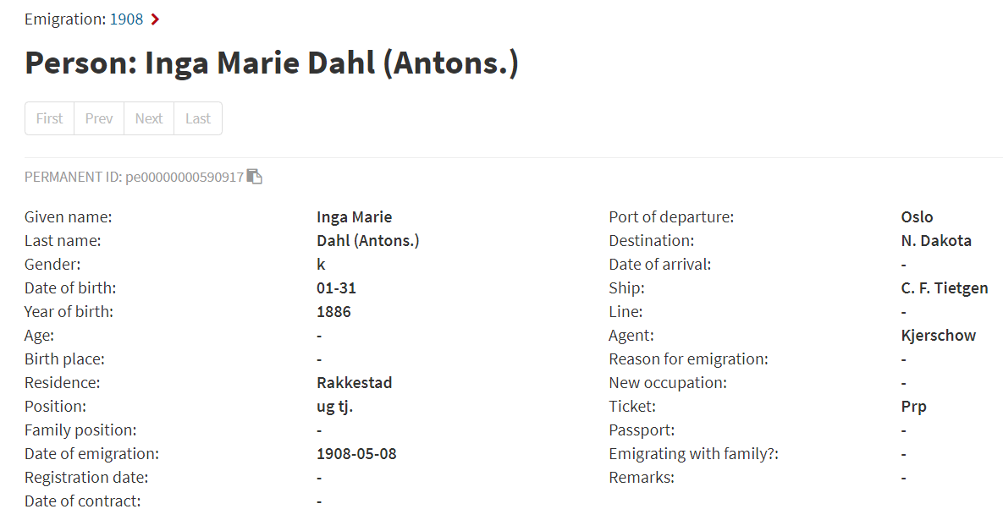
Inger Marie Antonsdatter:
She changed her last name to ‘Dahl’ before she left Norway.
Regional Archives of Norway: Emigrants from Oslo 1867 – 1930
https://www.digitalarkivet.no/en/view/8/pe00000000590917

Slide 98
Newspapers
Ship departures and arrivals were reported in local newspapers
If you know when and where your immigrant ancestors ship arrived, you may be able to find a notice in the paper
This may tell you when the ship departed, where it sailed from and other information about the voyage

Slide 99
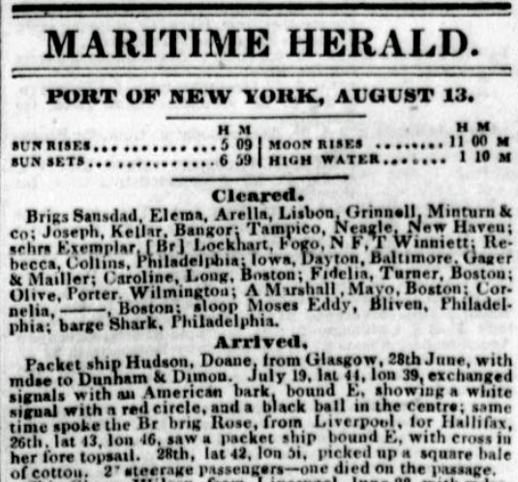
The New York herald. [volume] (New York [N.Y.]) 1840-1920, August 13, 1846, Image 4
Notes:
https://chroniclingamerica.loc.gov/lccn/sn83030313/1846-08-13/ed-1/seq-4/

Slide 100
Ship Ely Whitney, Dyer, (of Boston) 39 days from Havre, in ballast to Boyd & Hincken – 210 steerage passengers
The New York herald. [volume] (New York [N.Y.]) 1840-1920, August 13, 1846, Image 4

Slide 101
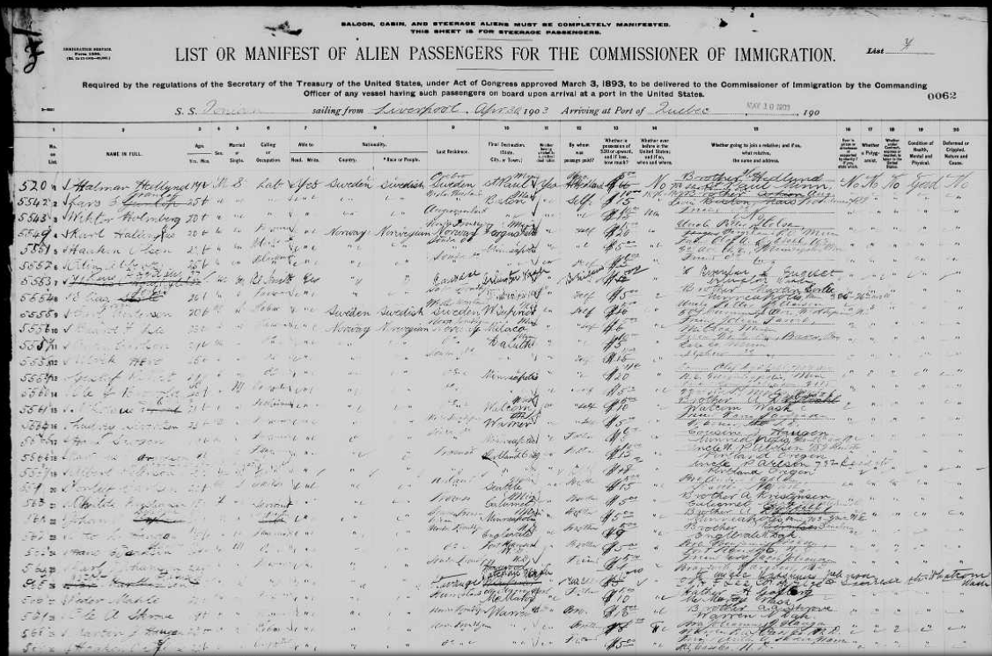
US-Bound Passengers Arriving in Canada
US-bound arrivals after 1894 were handled differently

Slide 102
St. Albans Border Crossing Records
All of the records created by the US Agents in Canada were sent to Montreal to be filed
These records were later moved to the INS district office in St. Albans, Vermont in the United States
They were micro-filmed and then destroyed
Records are sorted by port and date of arrival
A Soundex index for the cards was created
Vermont, St. Albans Canadian Border Crossings, 1895-1954 (Canada to the U.S.)

Slide 103
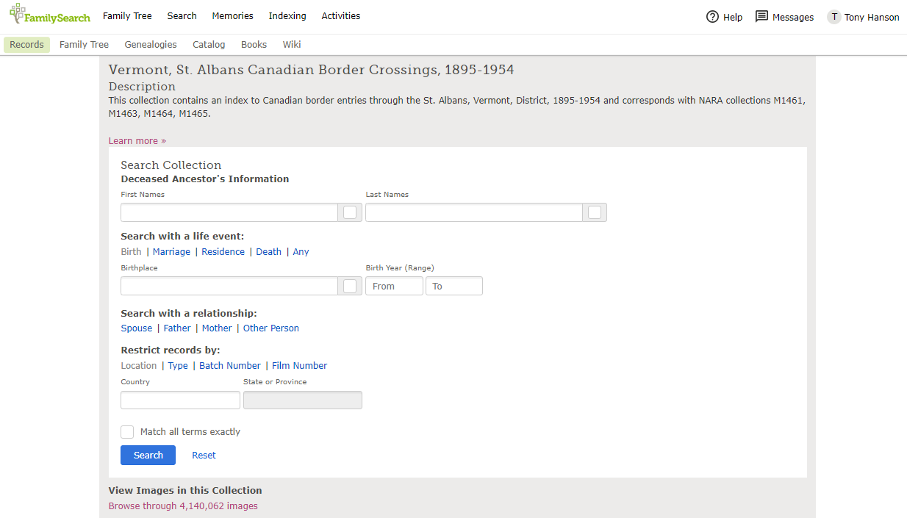

Slide 104
Notes:
"The Soundex index is in two series. The first (M1461) covers the years 1895-1924, and the second (M1463) 1924-1954. Each are composed of the individual card manifests (Form 528) arranged according to the Soundex code. Each card represents an abstract of the information found on the original passenger manifest or in the case of Canadian residents what would have appeared on a manifest. The cards also serve as an index to the manifests for non-Canadians. This publication includes the names of people who crossed the border in Washington, Montana, Michigan, New York, North Dakota, and Minnesota, in fact all along the U.S. Canadian border"--Canadian Arrivals, p. 4.
"The Manifests of passengers arriving in the St. Albans District through Canadian Pacific and Atlantic ports, 1895-1954, (M1464 and M1465) provides two types of lists. The traditional passenger lists on U.S. Immigration forms are found as well as monthly lists of names of aliens crossing the border on trains. These monthly lists are arranged by month, [and year] thereunder alphabetically by name of port, and thereunder by railway"--Canadian Arrivals, p. 5.
https://www.familysearch.org/search/catalog/452590?availability=Family%20History%20Library

Slide 105
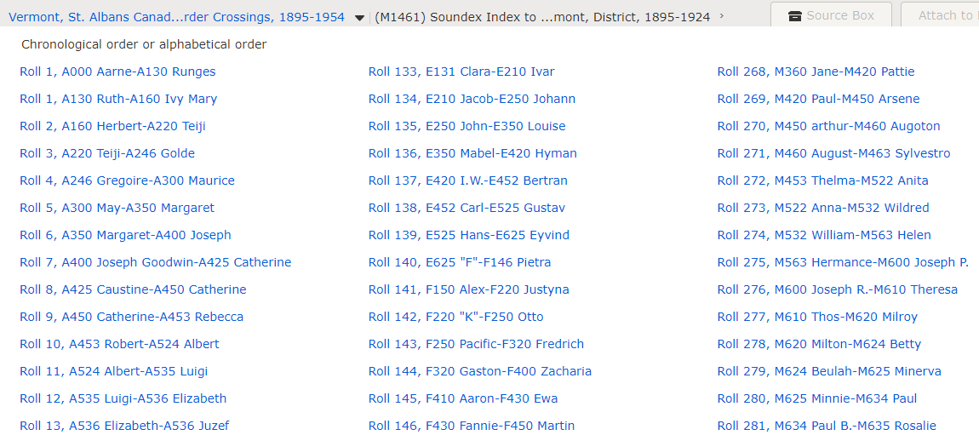

Slide 106
Still no luck?
Thoroughly document (add source) everything that is known
Document all known sources of information
Create a timeline of events
Determine earliest and latest possible dates of arrival
Create a hypothesis (theory)
Go through relevant image collections page by page
Record every search & the results
Consider hiring a professional researcher

Slide 107
Summary
Discover as much as you can about your ancestor
Know what records existed at the time they immigrated
Consider all possible routes of travel
Take advantage of online records
Be creative in searching

Slide 108
Summary
Knowing when your emigrant ancestor traveled is key
Identify the records that exist for that period of time
Anticipate inaccurate/incomplete indexing
Search for traveling companions
Don’t make assumptions about the route traveled
Document your research thoroughly
Don’t give up!

Slide 109
Questions?

Slide 110
Thank You!
Tony Hanson
aehanson@swbell.net
https://www.rayson.us/aehanson/presentations/current/atlantic-migration-to-america/

