Slide 1

Paper in the Cloud
A New Way to View Old Information
Notes:
Revised July 2022

Slide 3
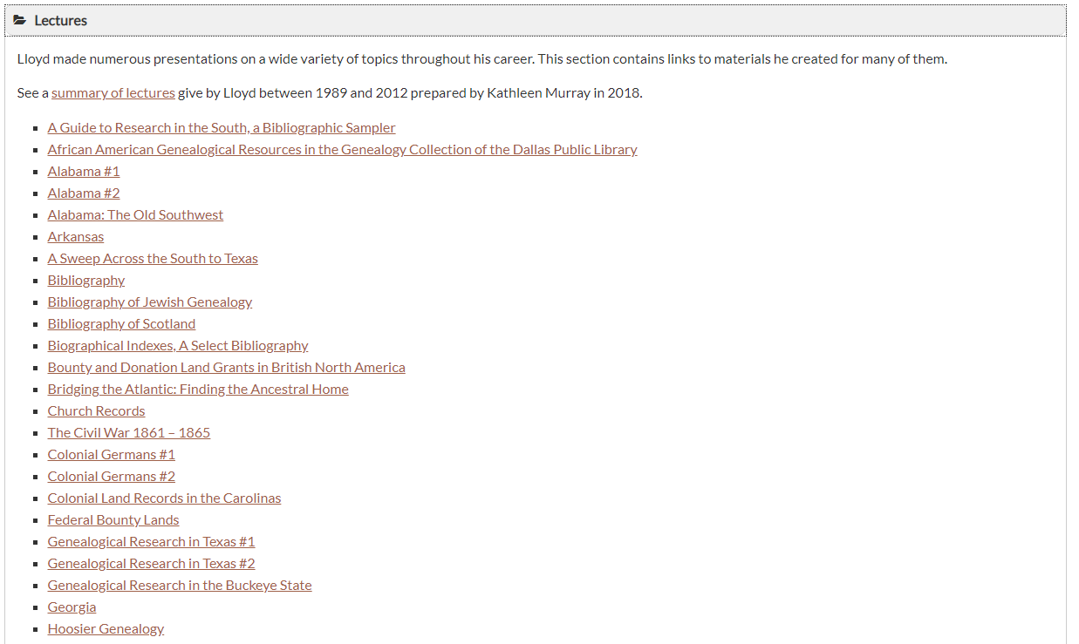


Slide 4
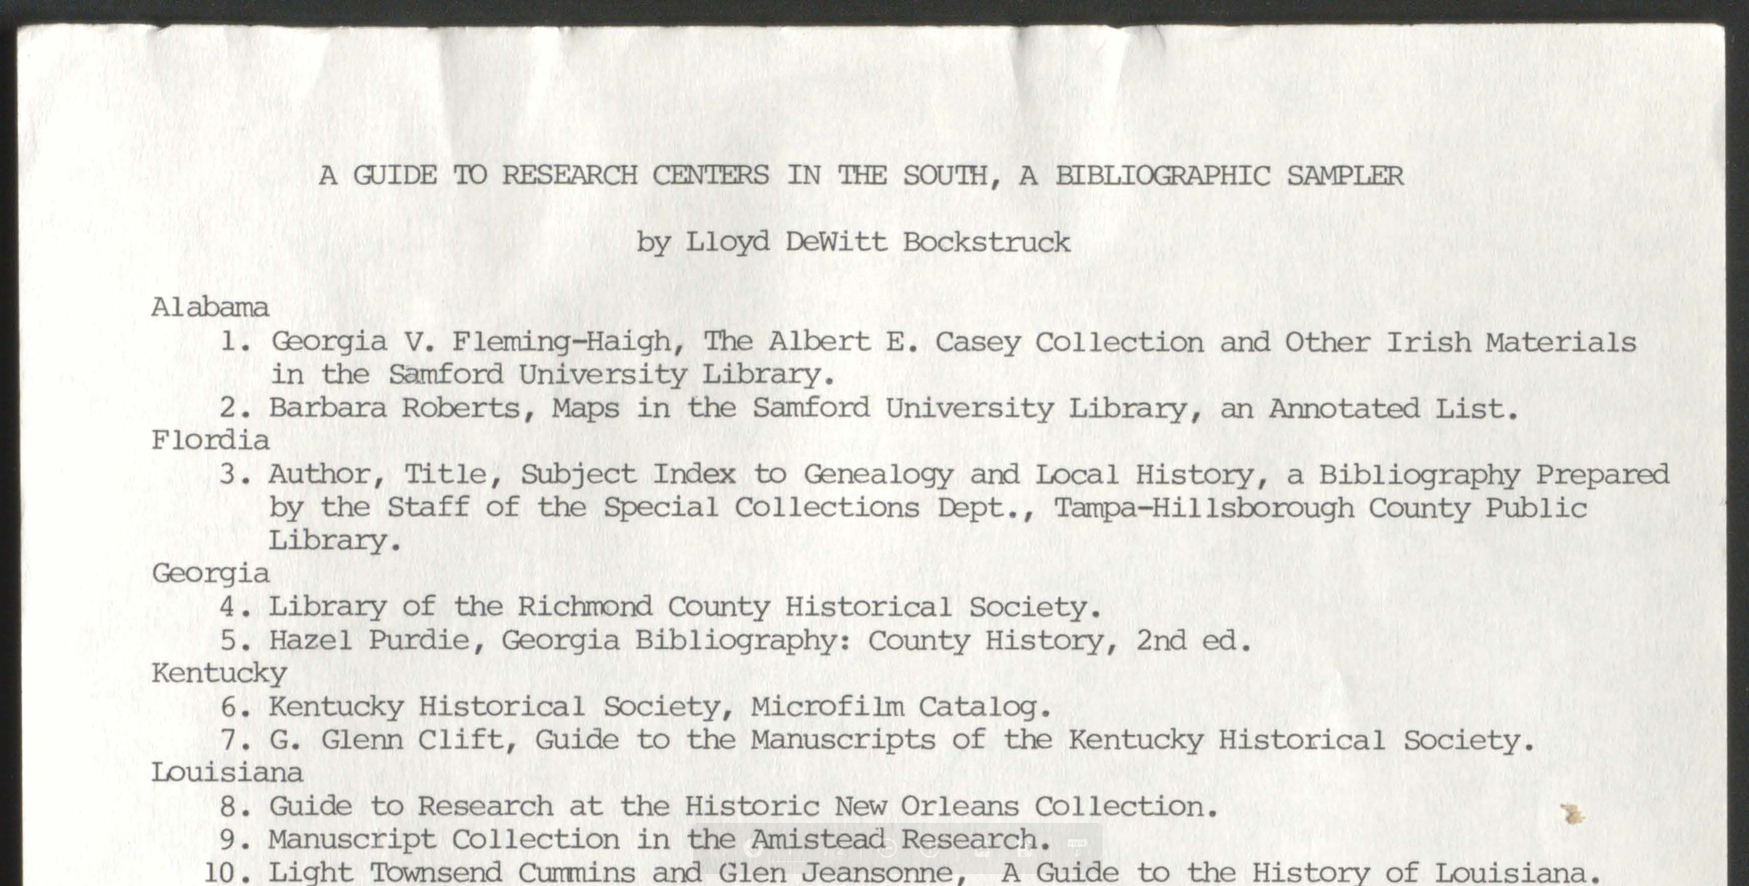

Slide 5
Overview
Present a digitization methodology
Demonstrate how digital images can be re-purposed
Case Studies
  Individual: Letters from my father
  Genealogy Society: Society Publications
Notes:
Genealogists soon find themselves overwhelmed by paper: records, letters, diaries, photographs, maps, and more. Learn a digitization strategy that will preserve for future generations these precious documents you’ve worked so hard to collect. Explore this digitization strategy through two case studies: a personal collection and a larger multi-year project implemented by a genealogical society.

Slide 6
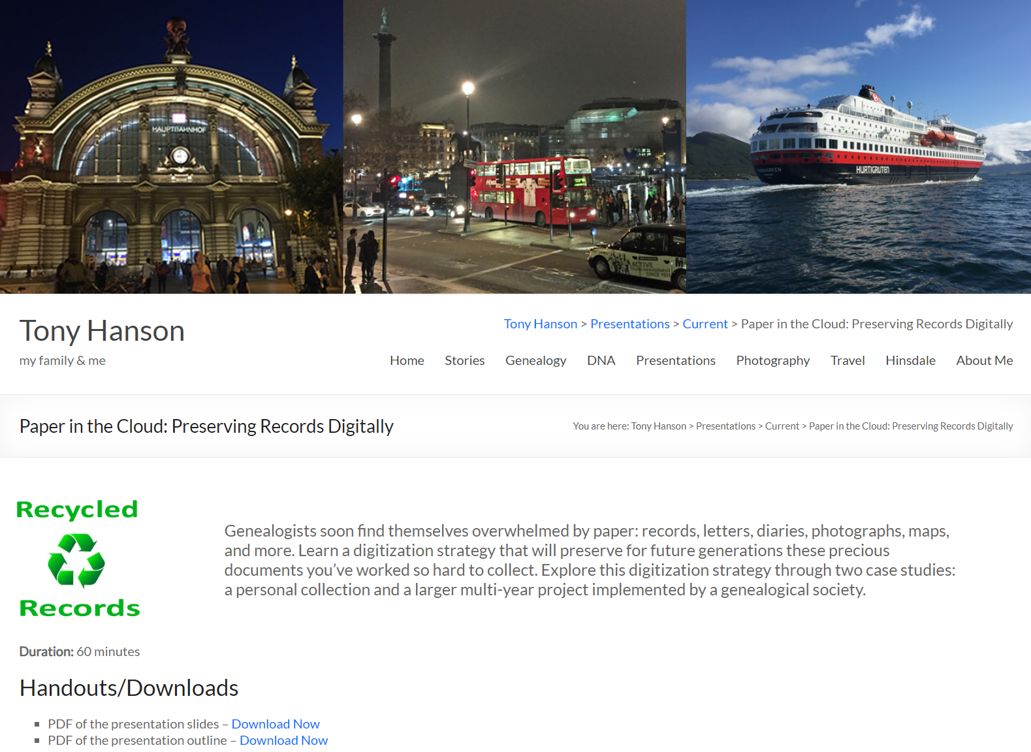
https://www.rayson.us/aehanson
Presentations > Current > Paper in the Cloud: Preserving Records Digitally

Slide 7
Digitization Methodology
Create an Inventory
Protect & Preserve the documents
Begin to look for missing materials
Create a Long-Range plan
Develop a digitization plan
Publish online
  Archive
  Website
Notes:
Protect & Preserve: Contains many of the same steps and a normal archival project. I will not be spending a lot of time on that aspect of a digitization effort.
Long Range Plan – Think “Years” not “Months”

Slide 8

Create an Inventory
Begin to document information about each item.
  Spreadsheet
  Text File
  Database
If this will be group project create the document in a way and in a place that will be accessible to the other team members

Slide 9
Information Used Throughout the Project
Initial information may be minimal
You will almost certainly come back and add more information as you move through the project
  Location
  Description
  Condition
  Digitization Status

Slide 10

Protect & Preserve what you have
Use archive quality sleeves, folders, paper and boxes
  Resistant to deterioration or loss of quality
  Suitable for long-term contact with important objects
  Safe and stable to museum or library standards.
See “Storing Family Papers and Photographs”
  https://www.archives.gov/preservation/family-archives/storing
  Has suggested suppliers.
Notes:
The National Archives page also has recommendations for suppliers.

Slide 11
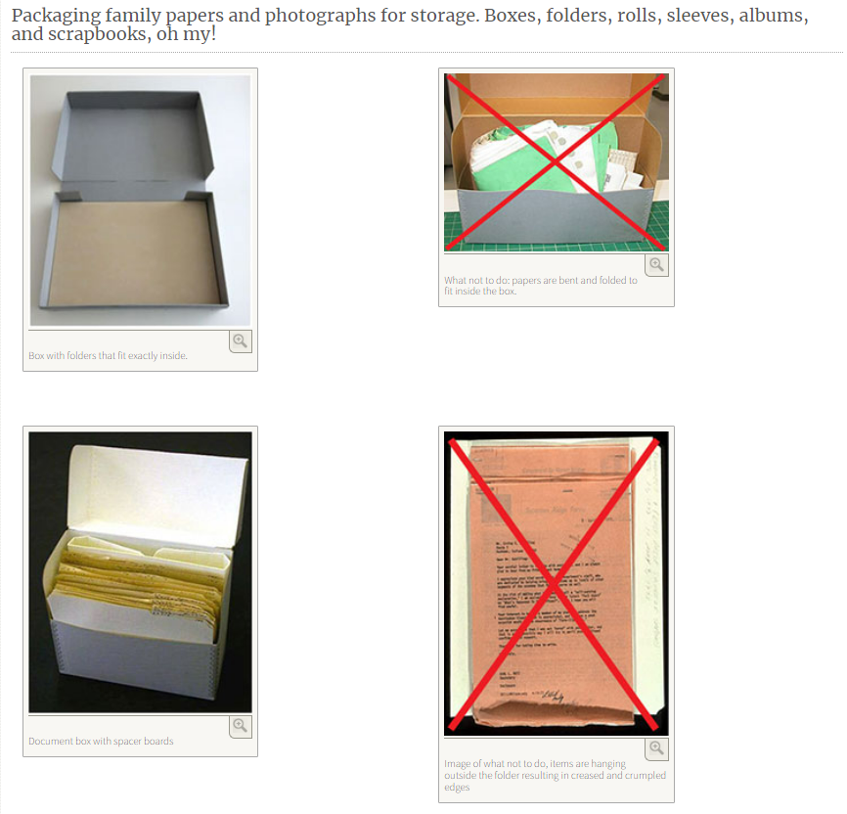

Slide 12
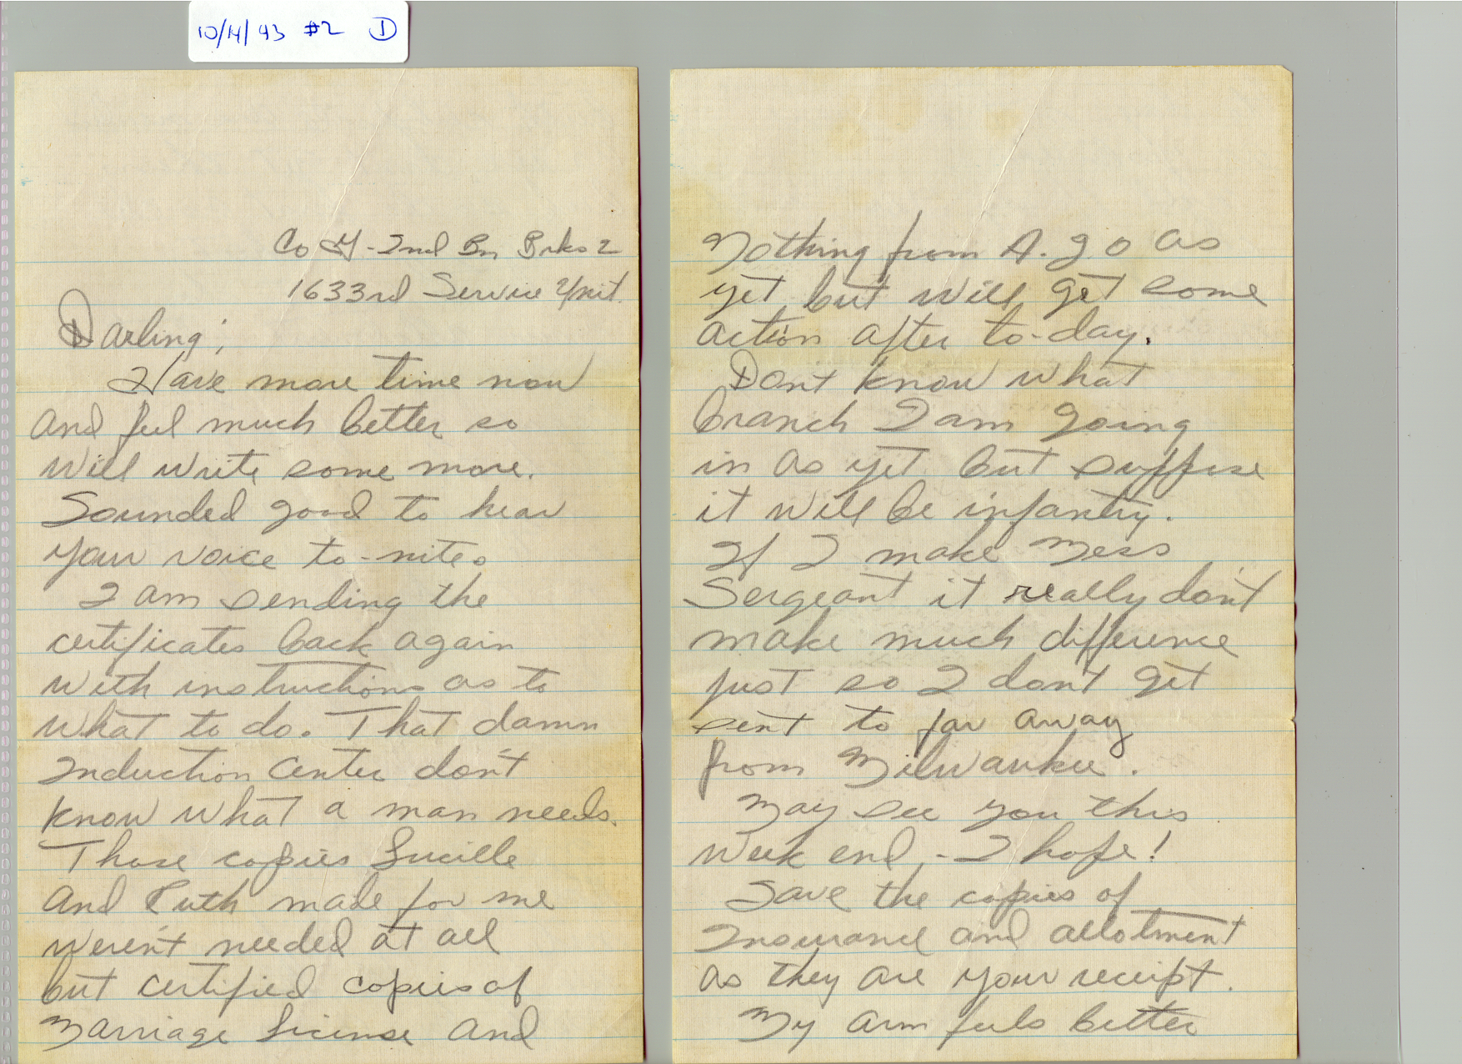

Slide 13
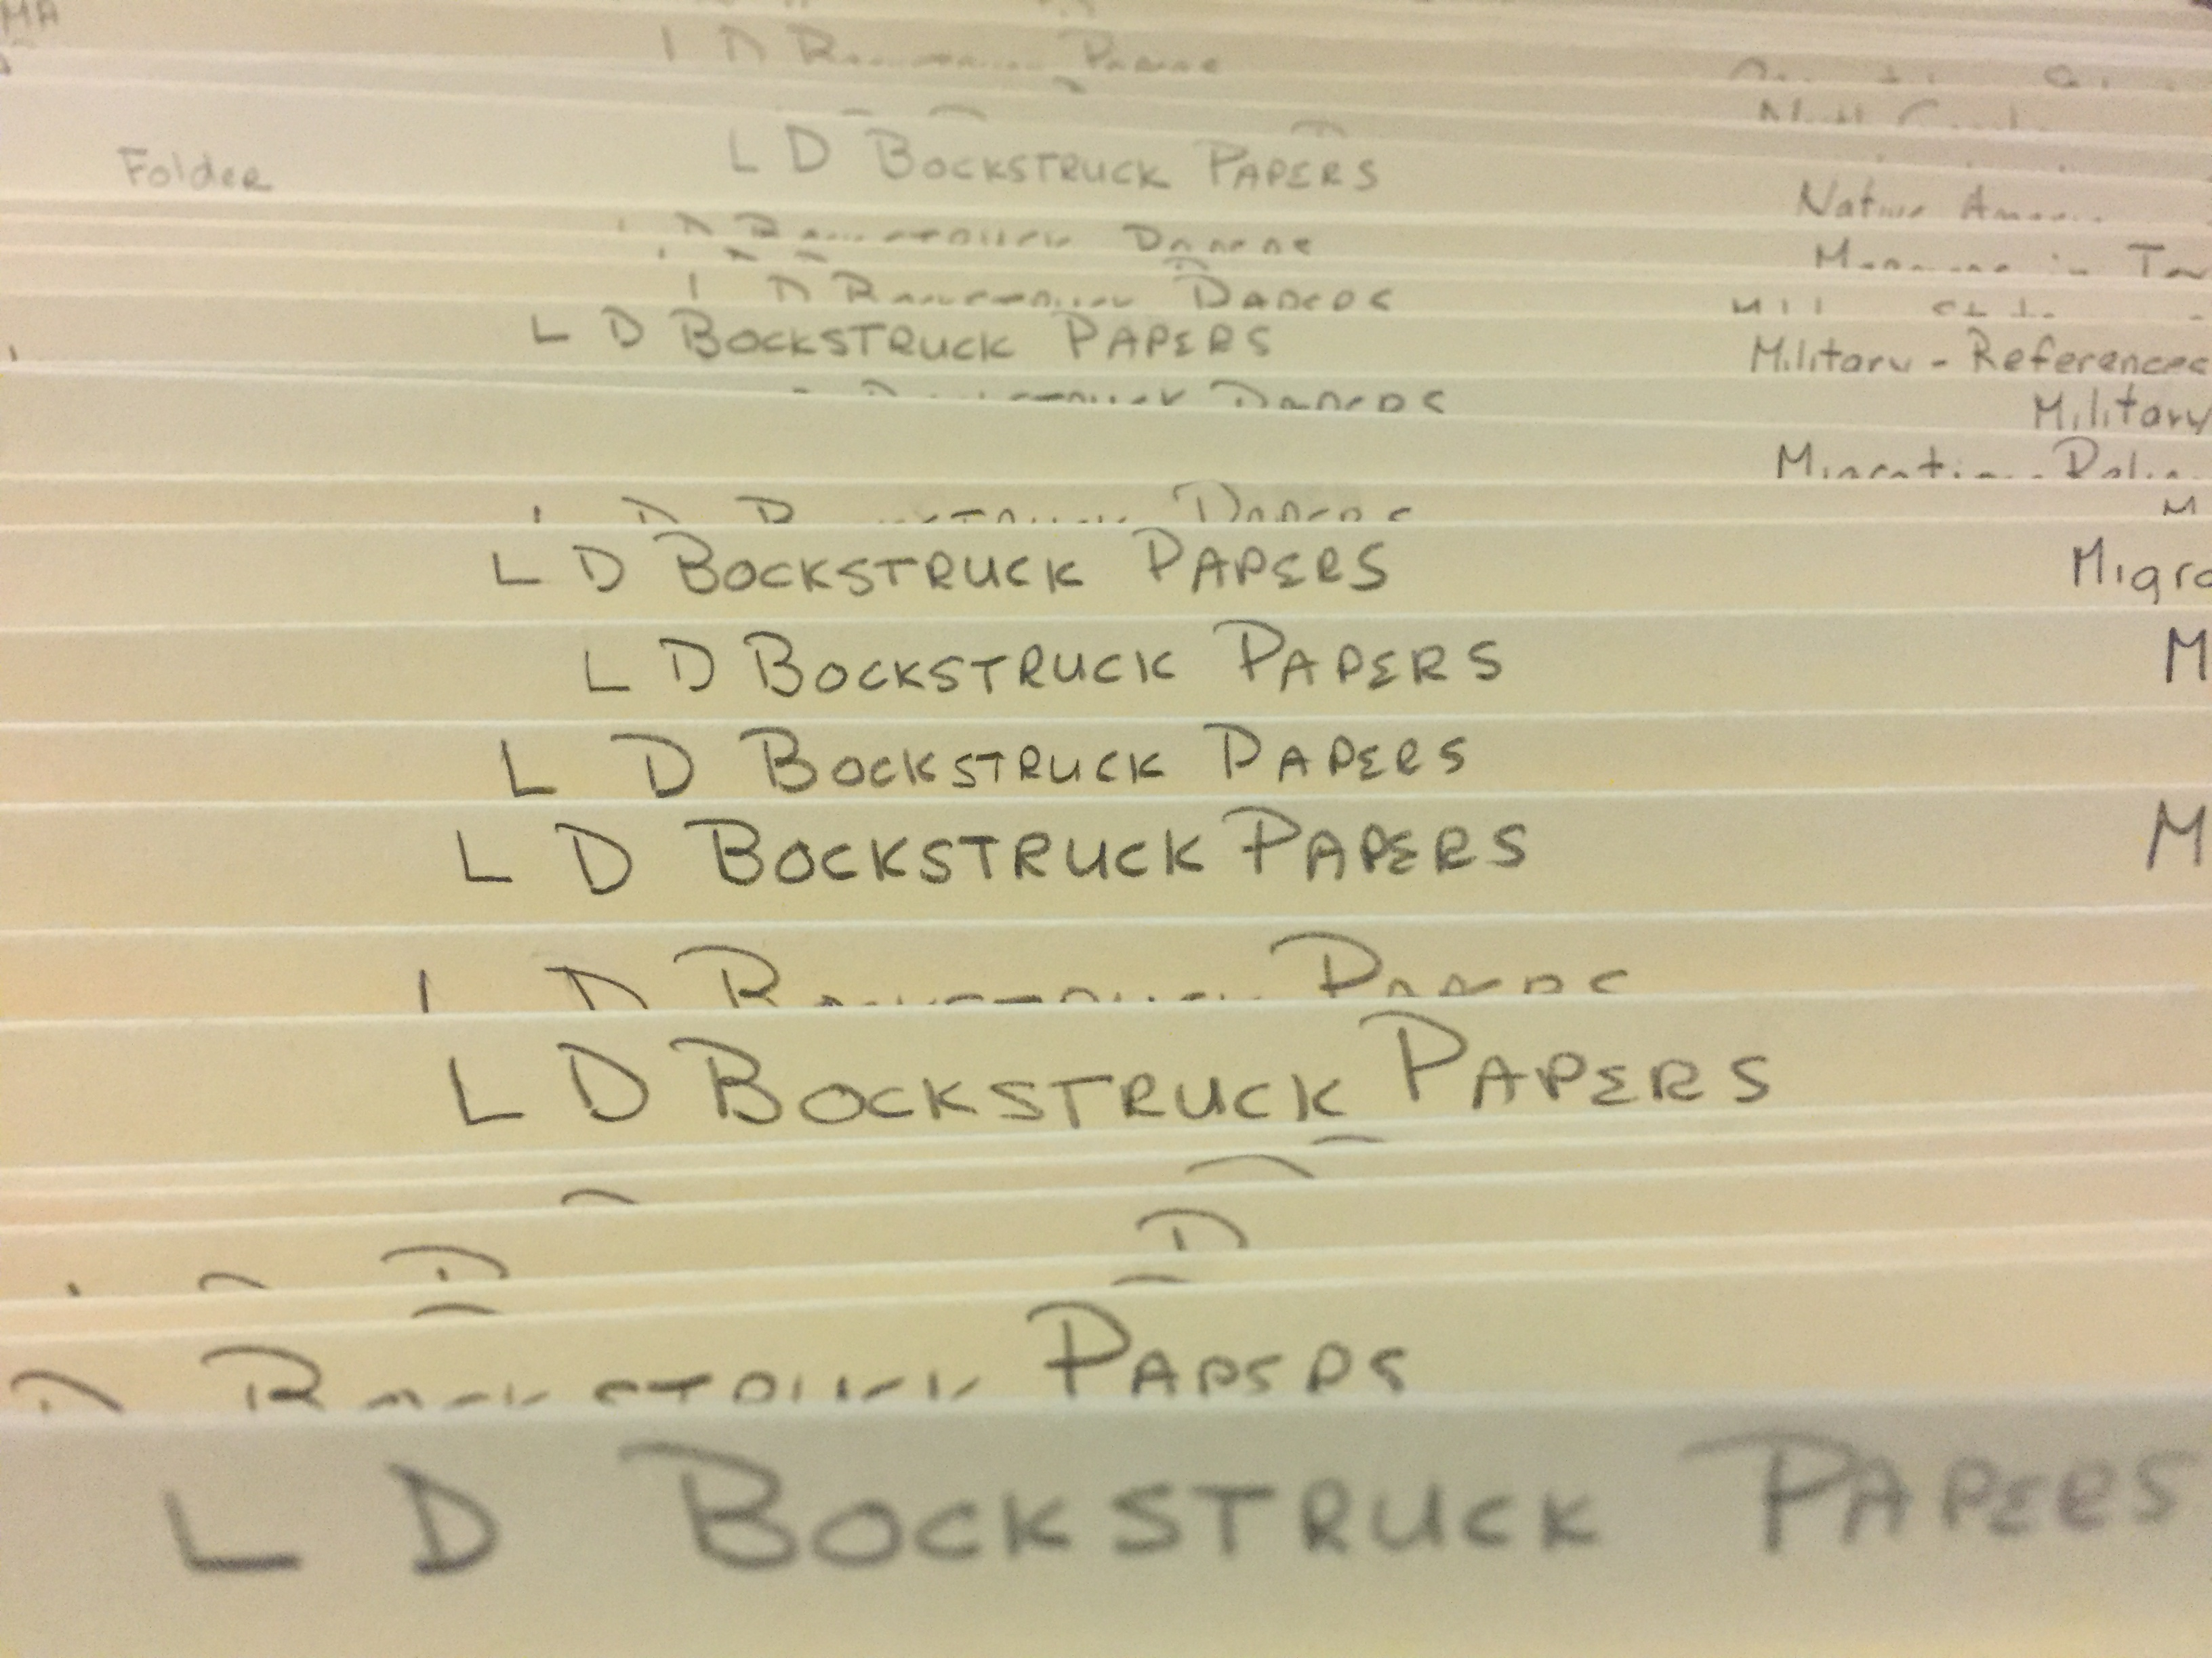

Slide 14
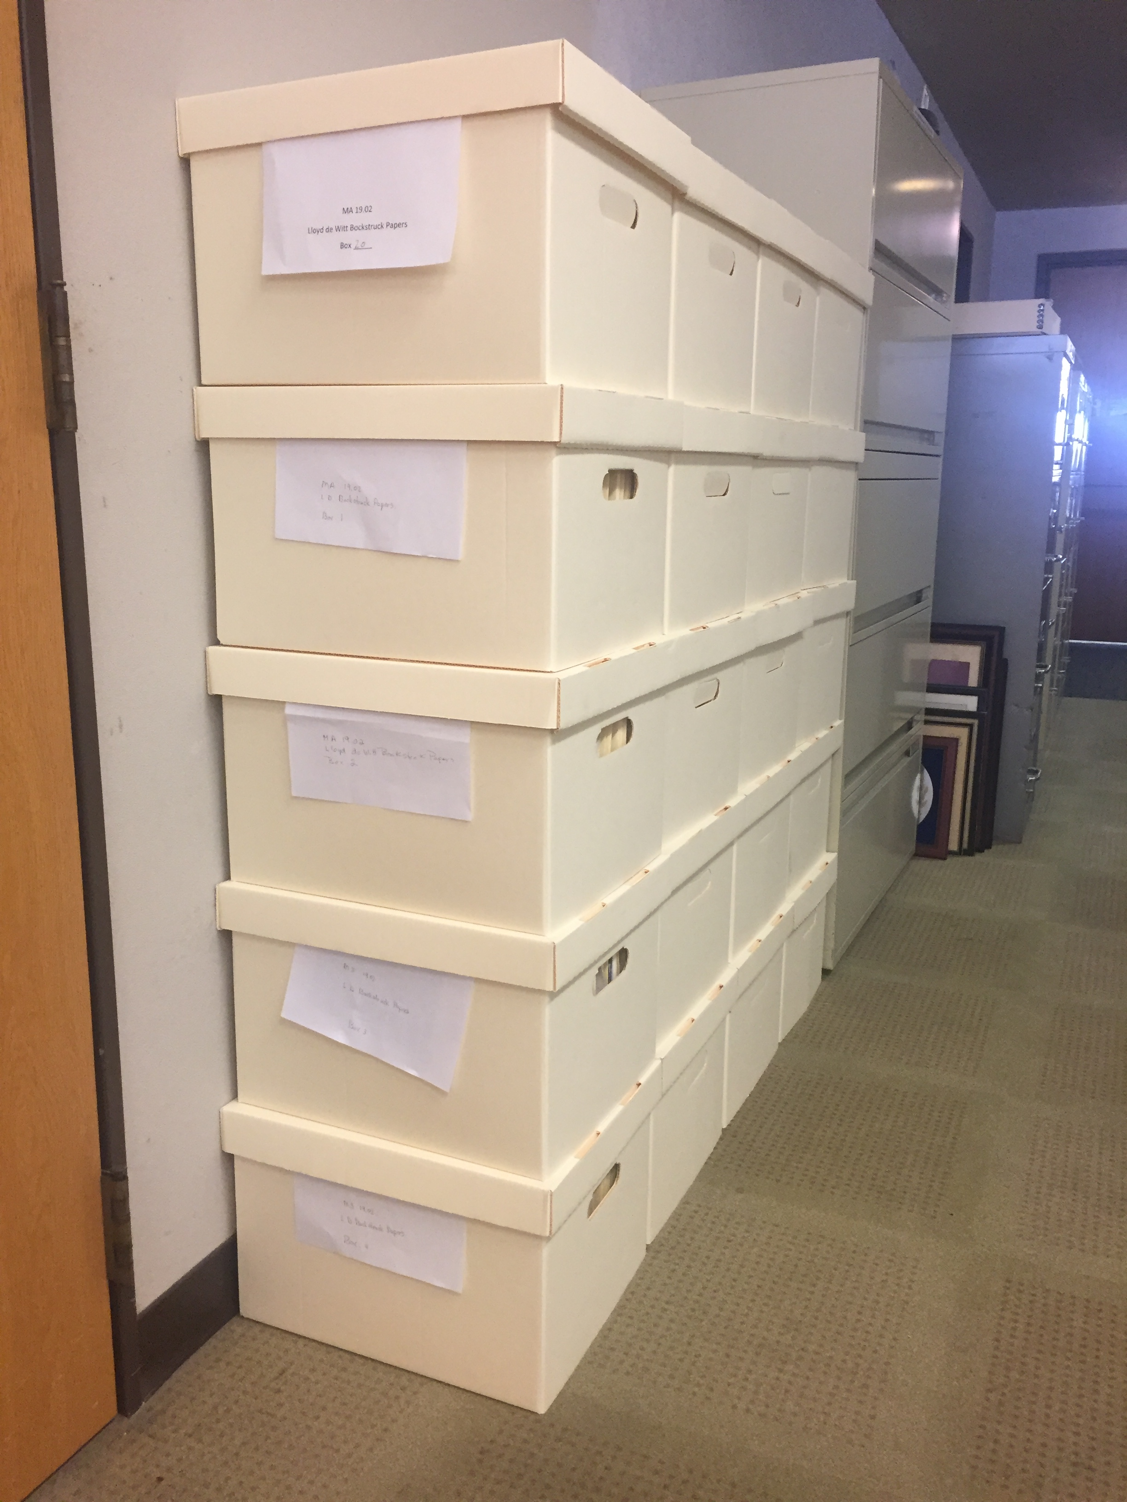

Slide 15
Protect & Preserve what you have
Store the materials in a safe location
  Temperature and humidity controlled
  Away from direct sunlight
  Away from potential hazards
  Interior rooms away from windows
See “Storing Family Papers and Photographs”
  https://www.archives.gov/preservation/family-archives/storing
Notes:
The National Archives page also has recommendations for suppliers.

Slide 16
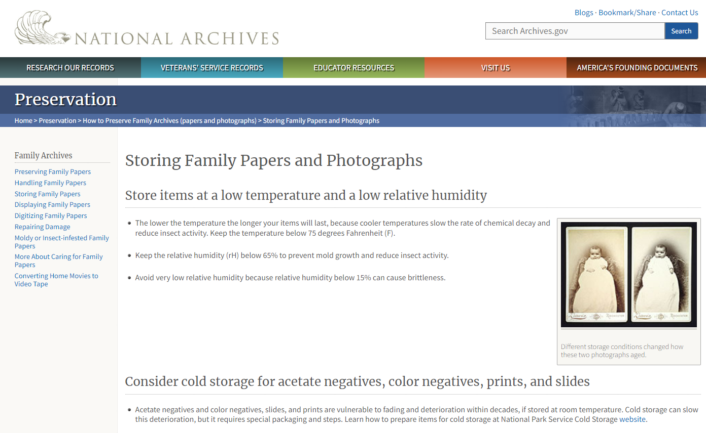

Slide 17
Begin looking for materials you are missing
Where will you look?
  Family Members
  Libraries
  Archives
  Other Publications

Slide 18
Develop a long-range plan
Create a vision for what you want to create when it is done.
Map out short-term steps you can take to begin working towards that goal.
Review and revise your long-range vision and short-term objectives periodically.
Think in terms of “Years”, not “Months”…
  Patience required!

Slide 19
Develop a digitization plan
Do it yourself
Pay a commercial scanning service
Find an archive that will do it for you

Slide 20
Doing it yourself
You will need a good scanning device
Determine where you will store the images
Create a backup plan
  Onsite & Remote
Create a file structure
Establish a file naming convention
Formalize Metadata plan
Determine Digitization Settings for each document
Notes:
We will dive deeper into File Structure, File Naming, Metadata and Digitization Standards in upcoming slides.

Slide 21
File Structure
Organize files in a way that makes sense for the collection
  Chronologically
    Year
    Month
  Document Type
  Name
  Location
  File Type

Slide 22

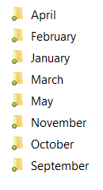


Slide 23
File names
The name of each file should provide information about the image
The file name should take advantage of how your computer normally sorts files so they will be displayed in the correct sequence
Notes:
The file name is probably more important for personal projects

Slide 24
1937_01_14_2_1.tiff
Page
Document Number
Day of Month
Month
Year

Slide 25
1937_01_14_2_1A.tiff
Side 1
Page
Document Number
Day of Month
Month
Year

Slide 26
1937_01_14_2_1B.tiff
Side 2
Page
Document Number
Day of Month
Month
Year

Slide 27
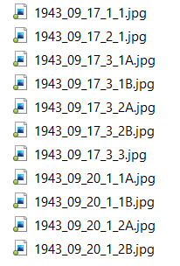
Sorting on Filename
creates a list of images
in the desired order

Slide 28
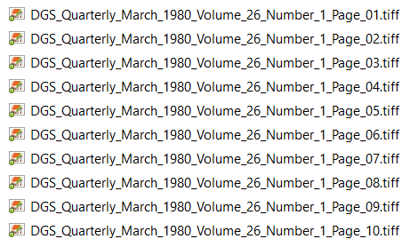
Would not work for a 100+ page document

Slide 29
Metadata
Information about the digitized document that is recorded in the image file.

Slide 30
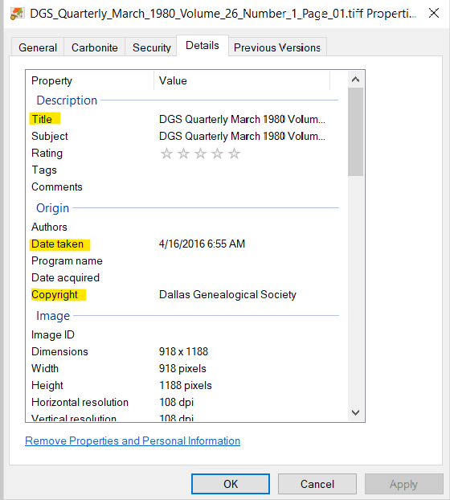

Slide 31
Metadata
Need to create a standard
  What to say and what field to record it in
May be easier to record this information at or near the time the files are being digitized
There are software packages available the allow you to do this for groups of files.
  XnViewMP is one example

Slide 32
Digitization Standards
It is important to select the optimal settings when you digitize the image.
The “optimal setting” depends (a lot) on what you are digitizing and what you plan to do with the images after they are digitized.
Choosing incorrectly (or not anticipating how you plan to use the images) can result in a lot of wasted time and effort.

Slide 33
Generally speaking: File Formats
TIFF is your best choice for long term preservation quality images
If JPEG (or other formats) are desired, they can be created from the TIFF images
Notes:
Settings may be changed without affecting image quality to reduce the file size

Slide 34
Generally speaking: Scanner Settings
Specific settings depend on the characteristics of the document you are scanning
Them may change from page to page
  Front and back covers may be scanned at different settings than the contents pages
  These changes will not affect the quality of the image
  But they will reduce the size of the file
Notes:
Settings may be changed without affecting image quality to reduce the file size

Slide 35
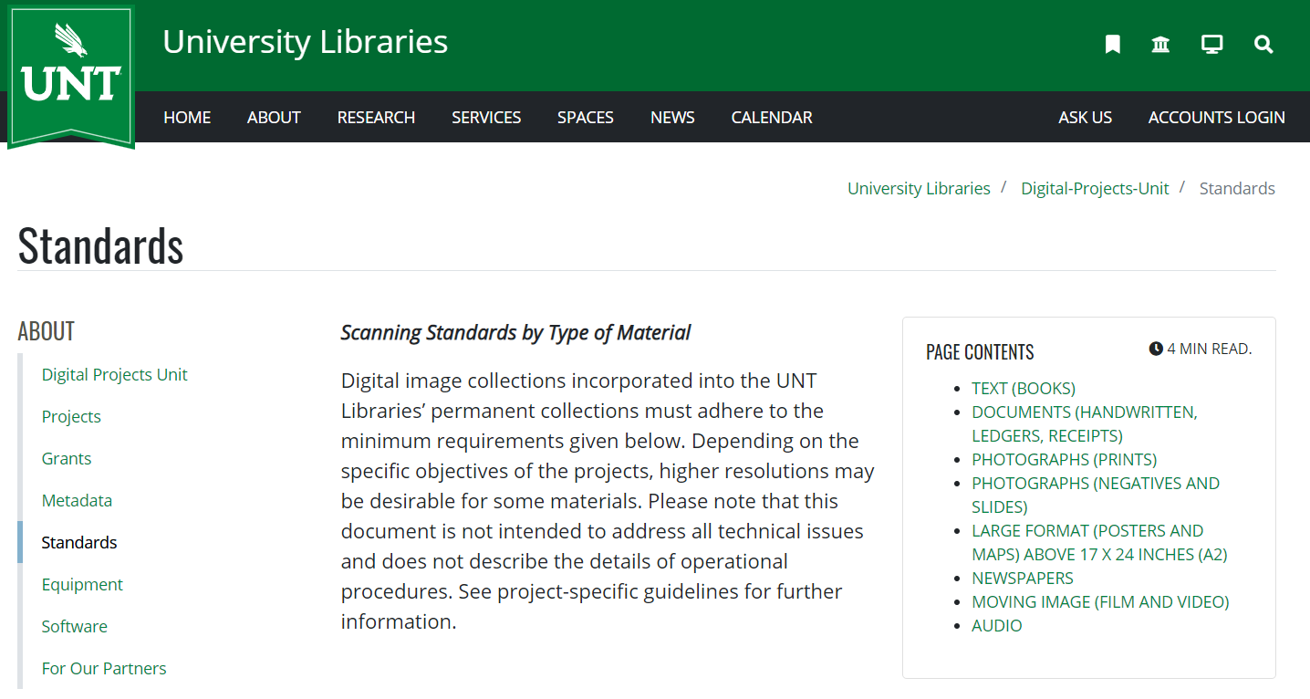
University of North Texas
Scanning Standards by Type of Material
https://library.unt.edu/digital-projects-unit/standards/

Slide 36
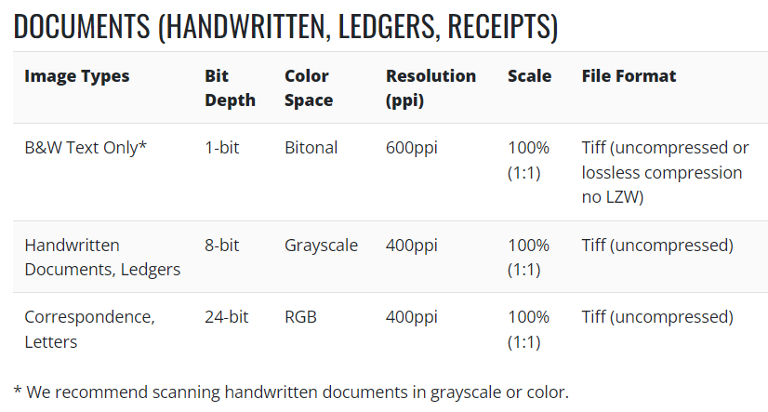

Slide 37
Commercial Scanning Service
Saves you a lot of effort.
You still need to make decisions about the digitization standards that will be used.
You may or may not be able to control:
  File Names
  File Organization
  Metadata

Slide 38
Working with an archive
Finding an archive that wants to digitize your collection eliminates the need to digitize the images yourself

Slide 39
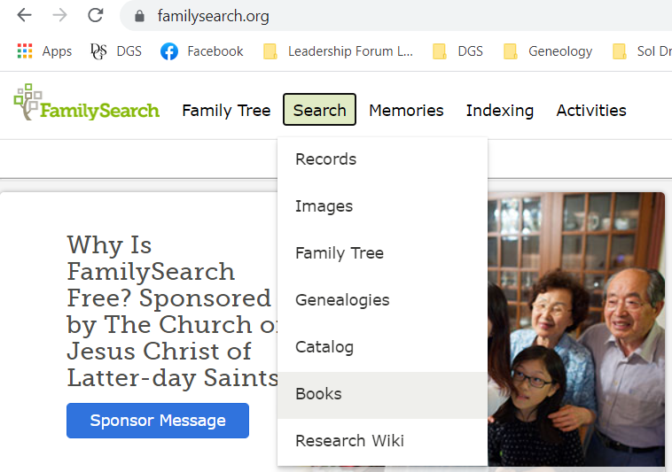

Slide 40

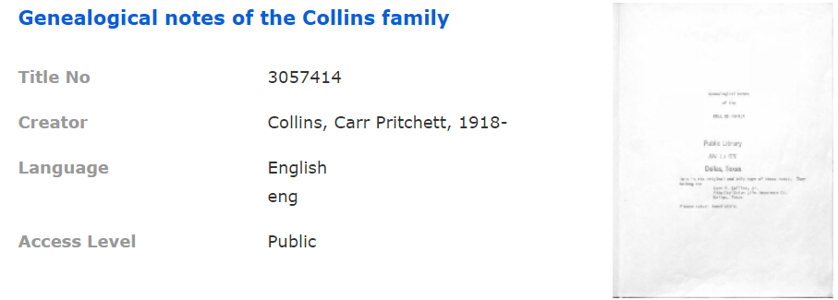

Slide 41
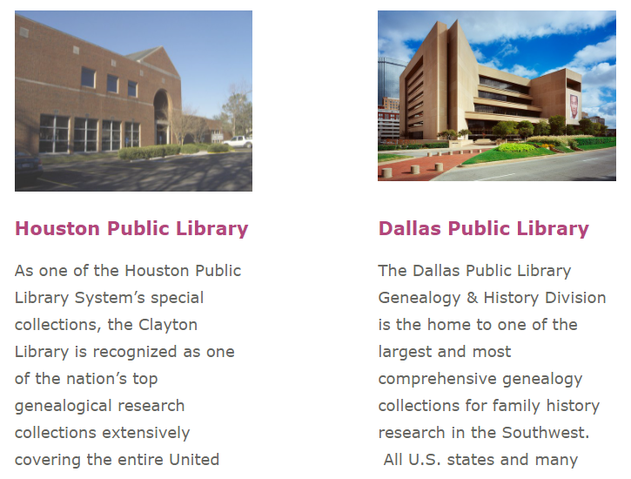

Slide 42
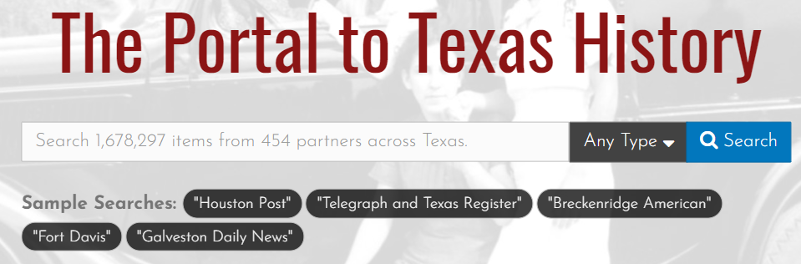
The Portal to Texas History
The Portal to Texas History (University of North Texas) is one of the largest and most active
Launched in 2004, they now have millions of images
They fund projects through their annual Rescuing Texas History grants
See their website for current information
Notes:
https://library.unt.edu/digital-projects-unit/partners/funding-opportunities/?utm_source=digital-projects-unit/funding-opportunities&utm_medium=301

Slide 43
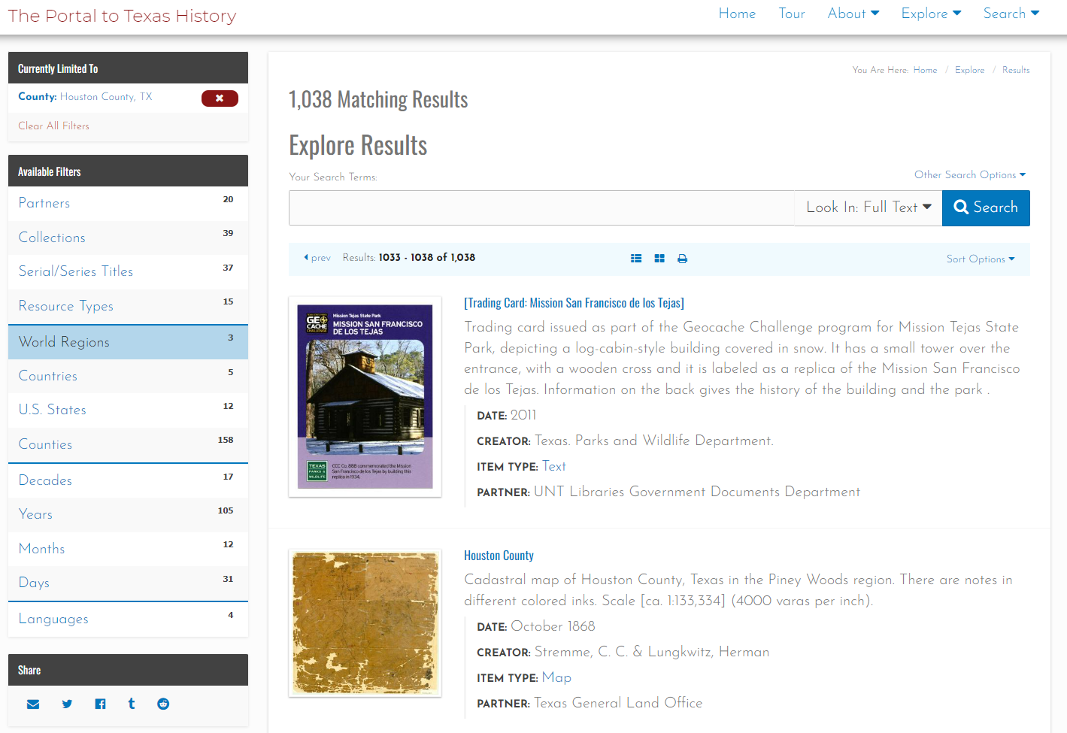

Slide 44
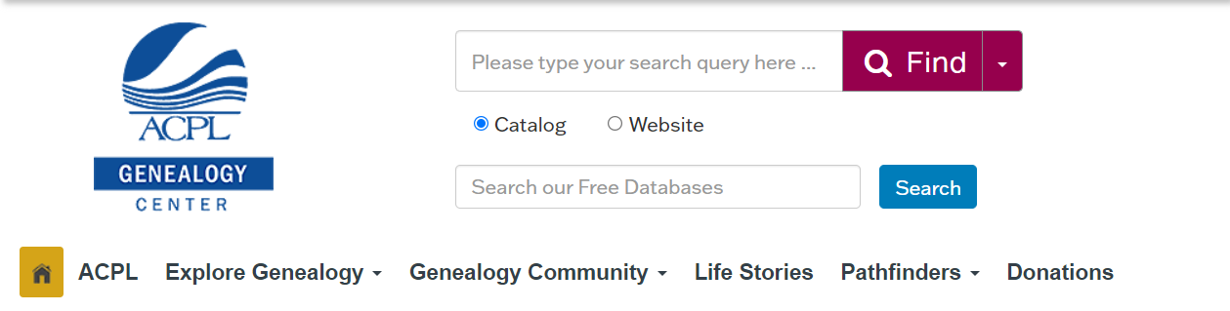
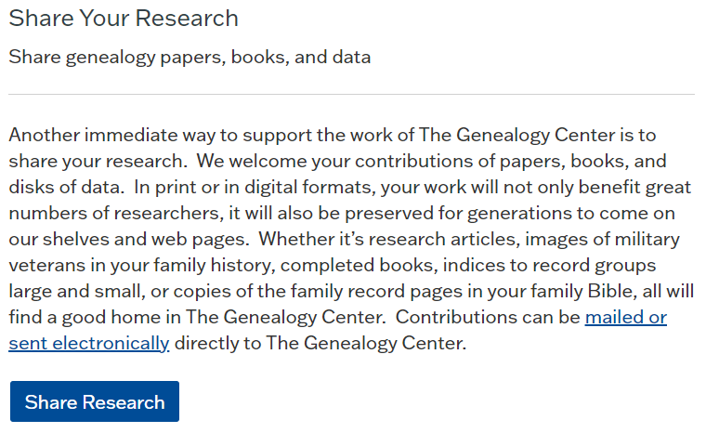
Notes:
https://acpl.lib.in.us/donations

Slide 45
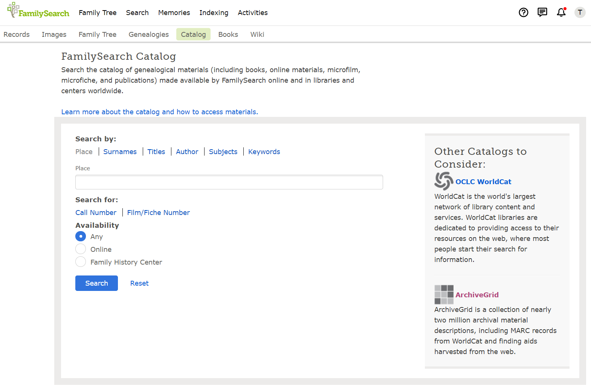

Slide 46

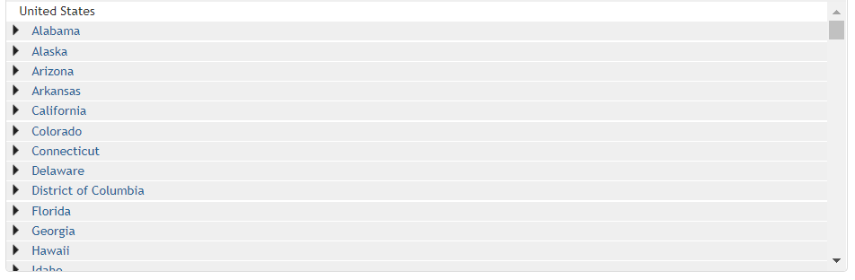

Slide 47
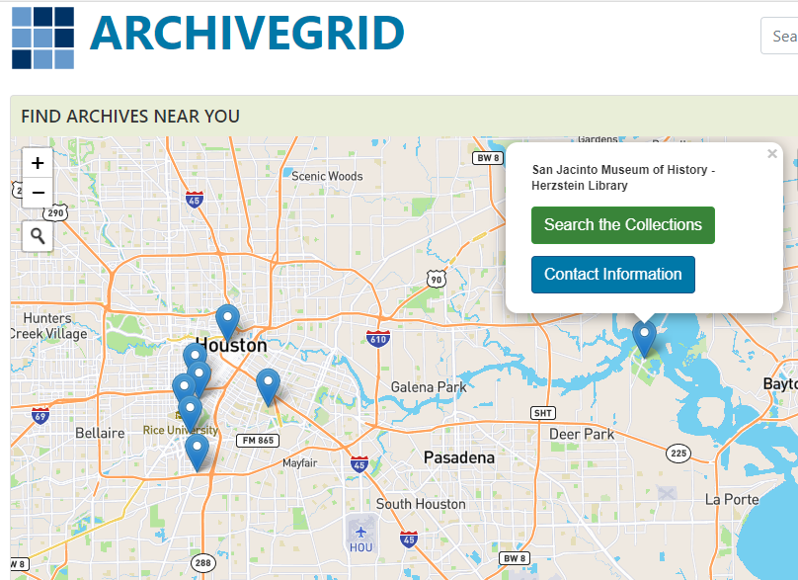

Slide 48
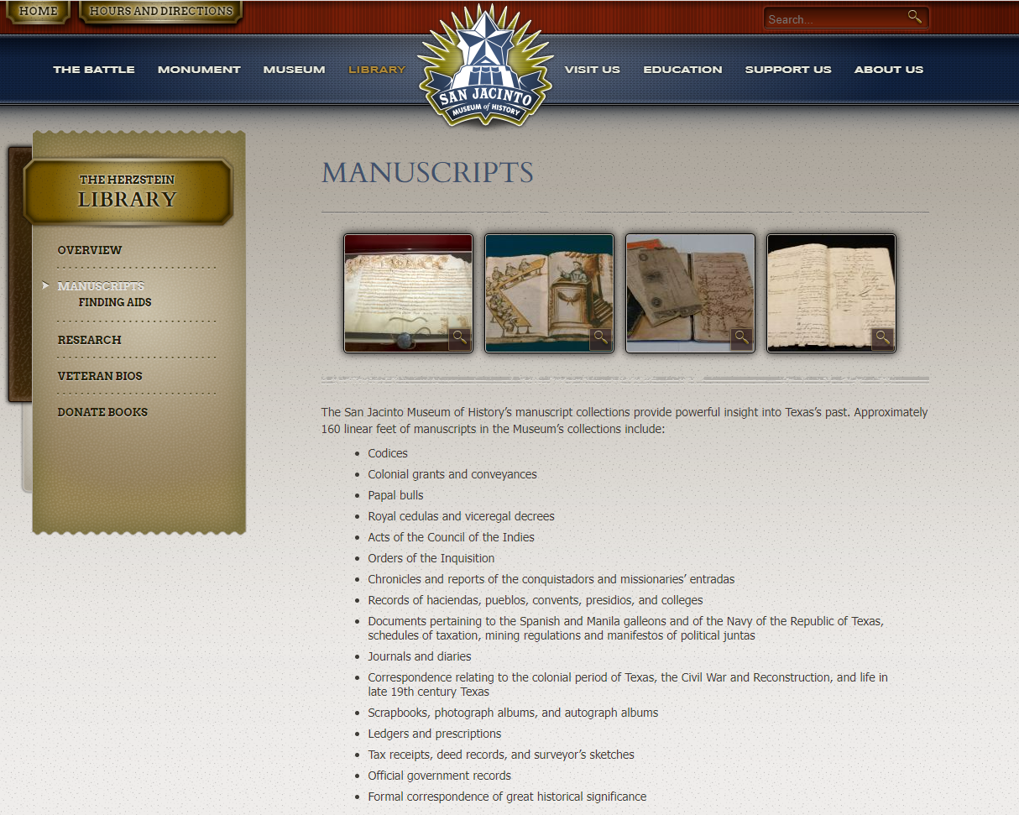

Slide 49
Archive considerations
How will your documents get to their digitization facility?
Are you willing to allow them to cut binding or otherwise separate pages to facilitate digitation?
What happens to the documents once they have been digitized?
Will they provide you with copies of the digital image files they create?

Slide 50
Publish On Your Own Website
There are some free options
More choices (and more storage) will cost you ($100 – $250/year)
You will most likely NOT be able to upload TIFF files
  Requires too much storage
    There is no such thing as “Unlimited Storage”…
  Use PNG or JPG instead
See “How to Create a Personal Website for Free”
  https://superbwebsitebuilders.com/how-to-create-a-personal-website/

Slide 51
Digitization Methodology
Create an Inventory
Protect & Preserve the documents
Begin to look for missing materials
Create a Long-Range plan
Develop a digitization plan
Publish online
  Archive
  Website
Notes:
Protect & Preserve: Contains many of the same steps and a normal archival project. I will not be spending a lot of time on that aspect of a digitization effort.
Long Range Plan – Think “Years” not “Months”

Slide 52
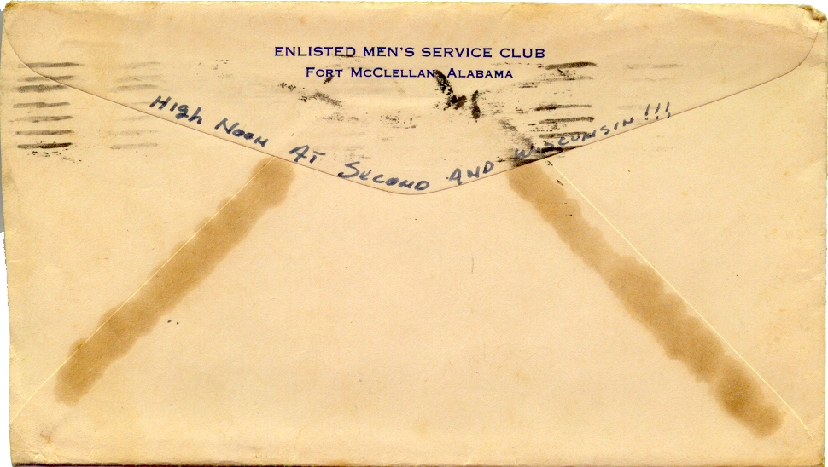
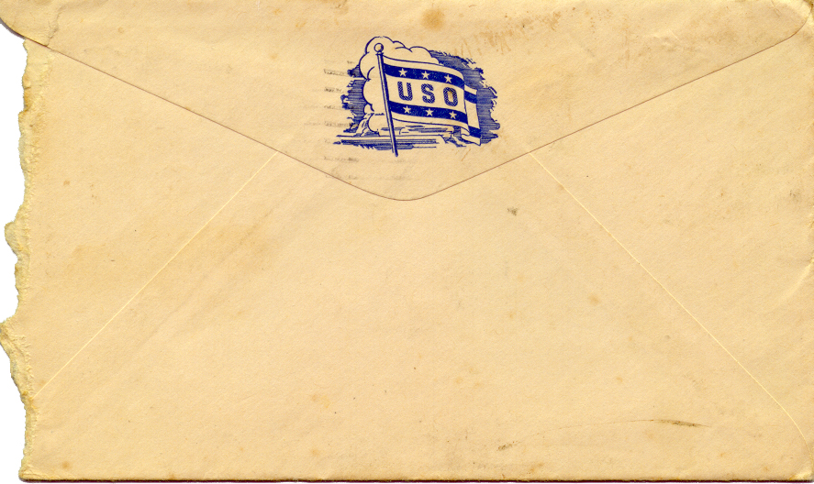
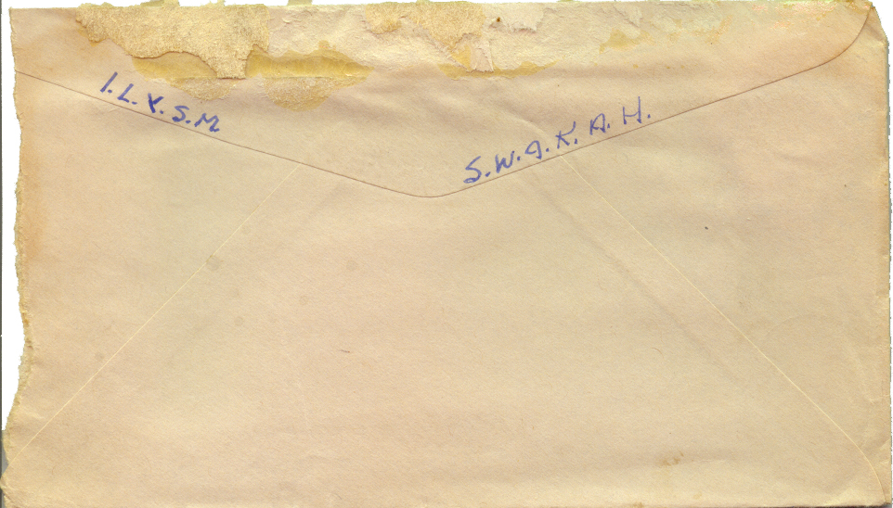

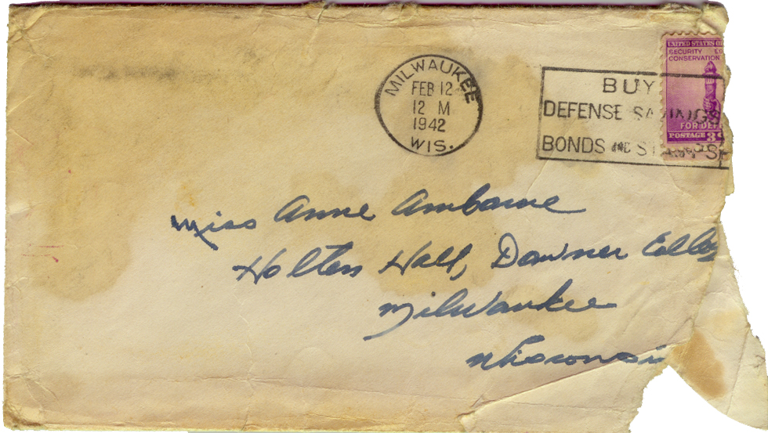
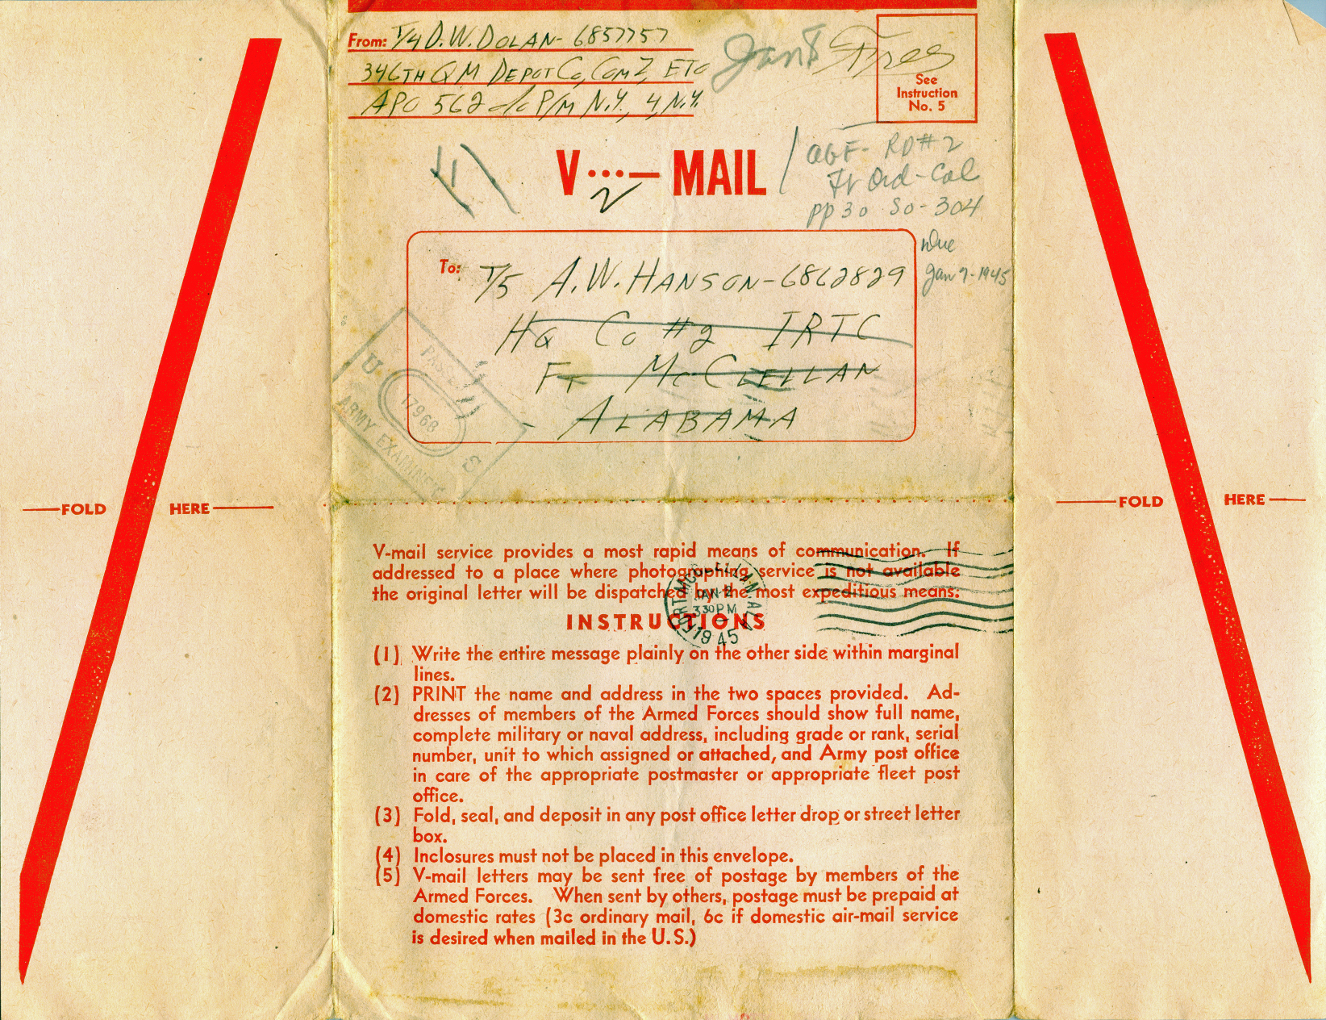
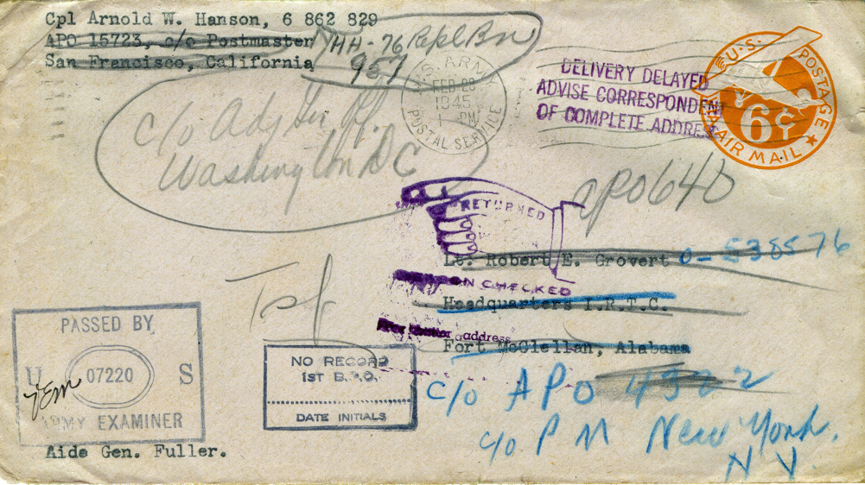
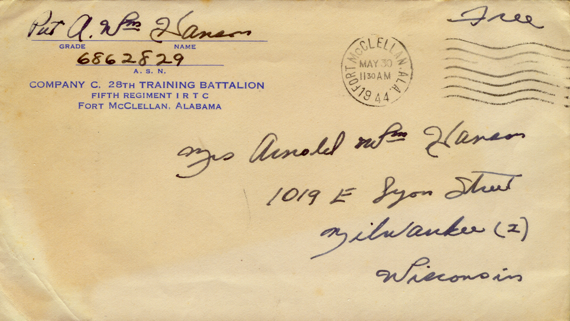
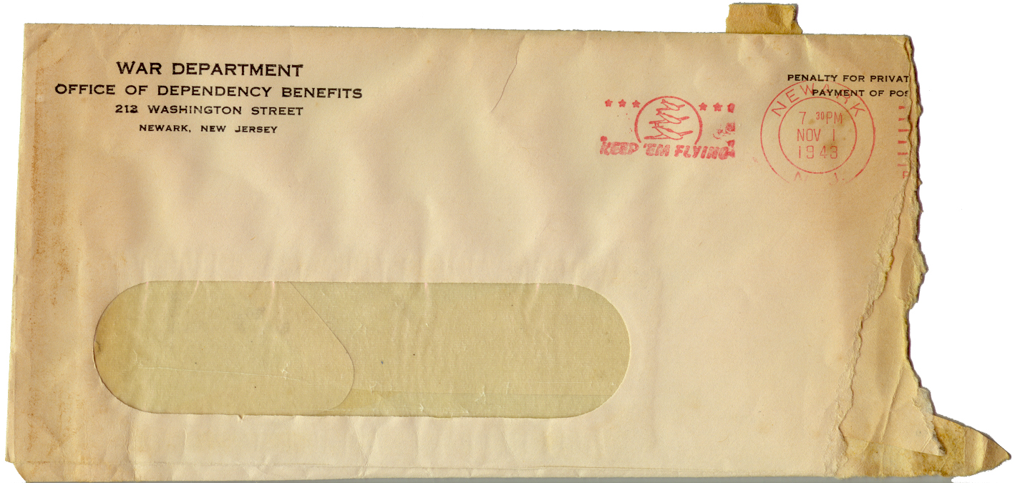
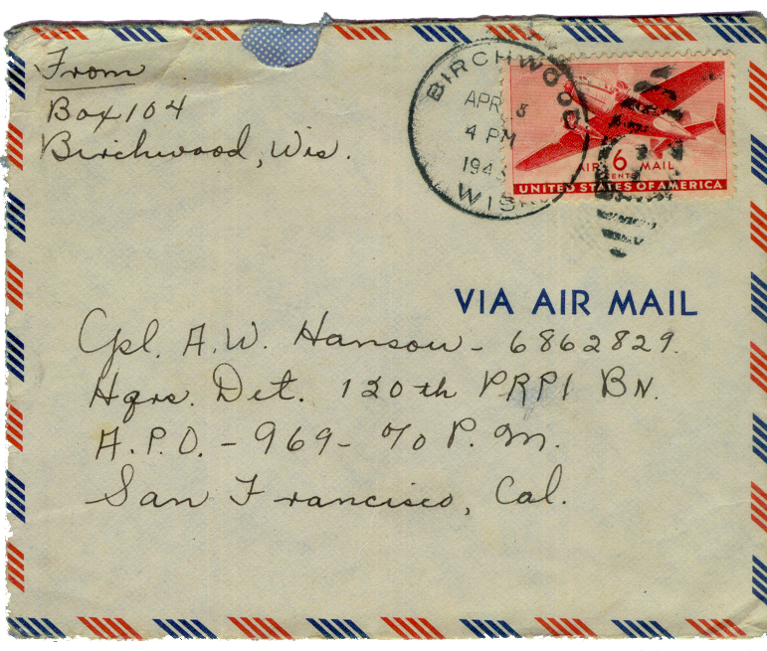
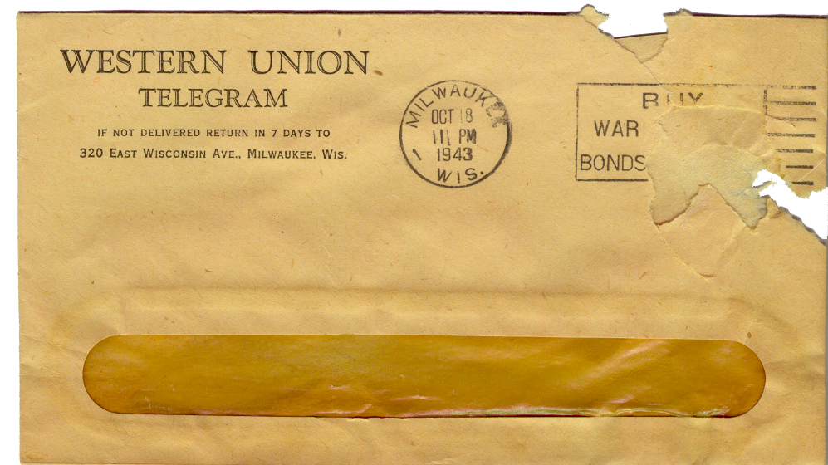
Case Study #1: My Fathers Letters

Slide 53
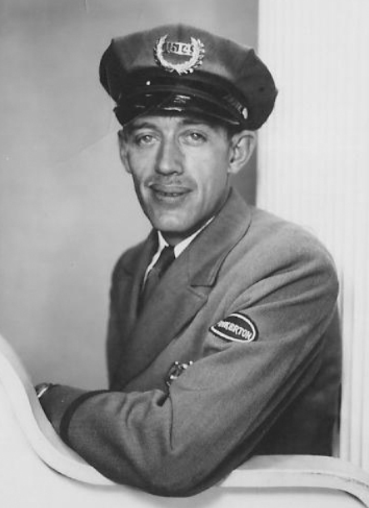
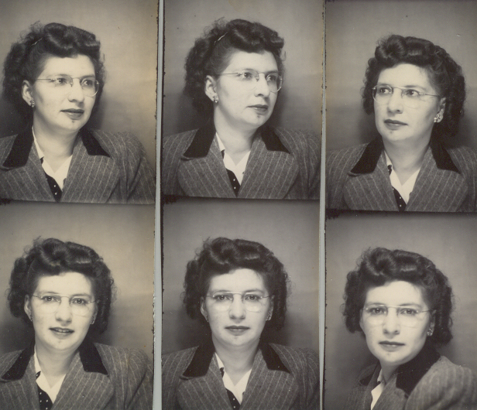
Background
Begins in 1943 when:
  My parents were married
  They had their first child
  My father left a 19-year-old bride and 4-month-old daughter for “the duration of the way plus 6 months”
My mother was raised as an only child
  She did not have much experience with caring for an infant
My father was a prolific letter writer
  Usually wrote at least one letter every day
  630 letters
  3300+ Images
Notes:
I’m grateful on a personal level that these letters exist because my father died shortly after my 16th birthday. My memories of him are those of an adolescent. Being able to read these letters has provided me with a lot if insight into my fathers life.
They also provide a unique and intimate view into the lives of a couple separated by the demands of a world war.
And frankly, I’m a little surprised they survived long enough for me to have them digitize.

Slide 54
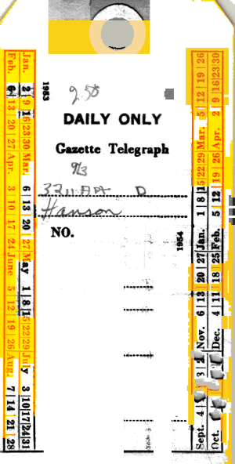
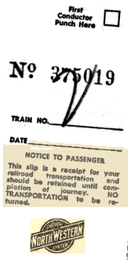
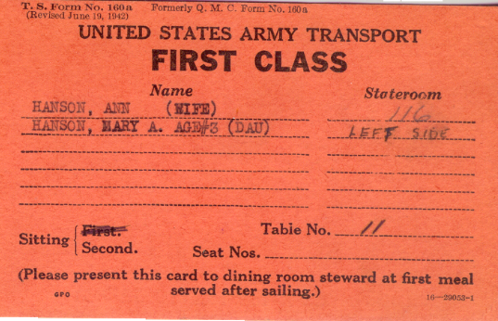
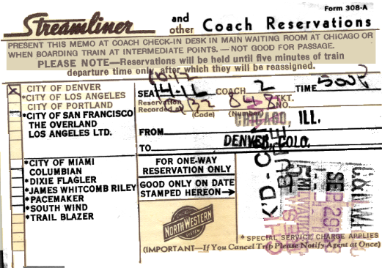
The places these letters have been…
Survived the war and moves to Hawaii, Kansas, Colorado, Michigan, back to Colorado and Chicago when dad retired in 1960
Stored in several Chicago area basements until 2000
I brought them to Dallas in 2000
They have resided in Fort Wayne, Indiana since 2018
Notes:
3,392 images

Slide 55
Boxes full of Envelopes

Slide 56
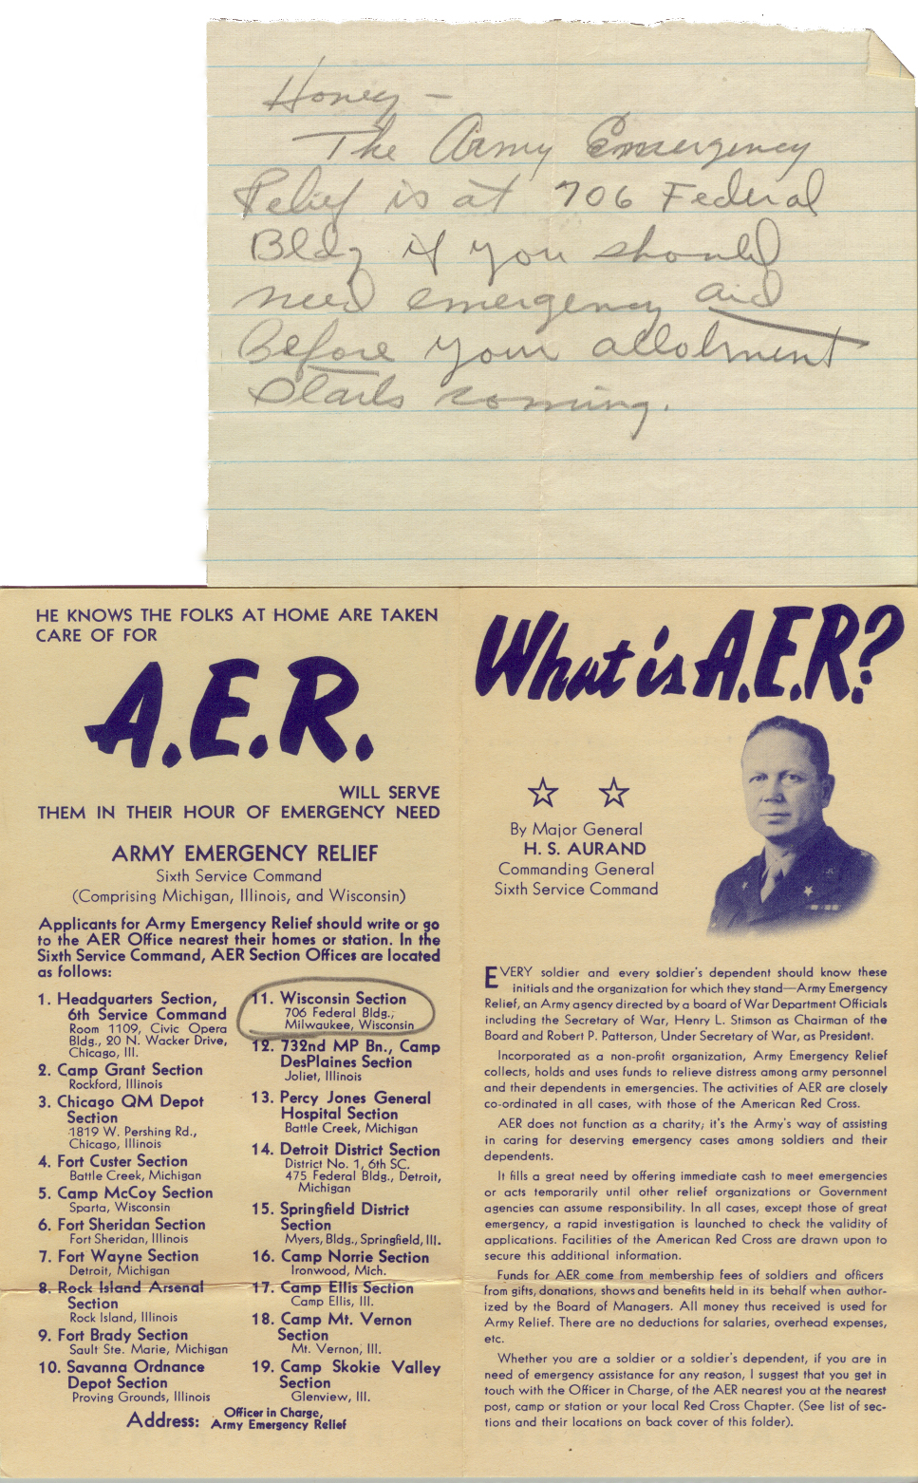
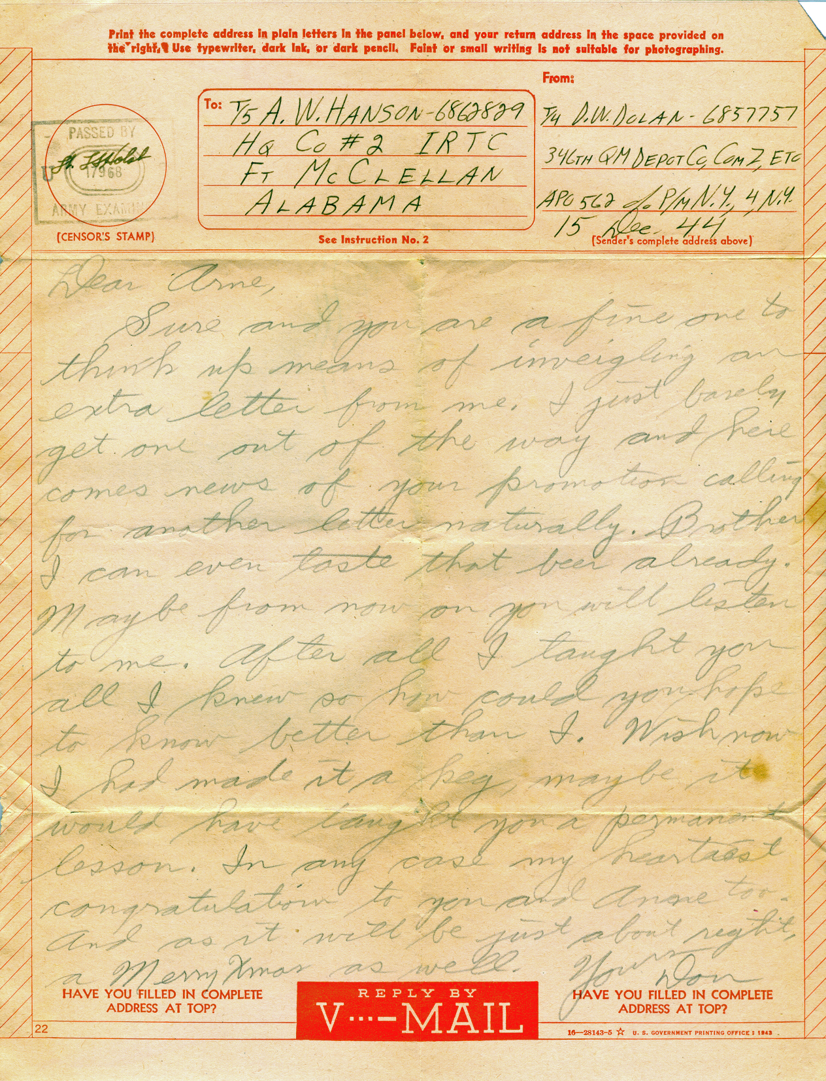
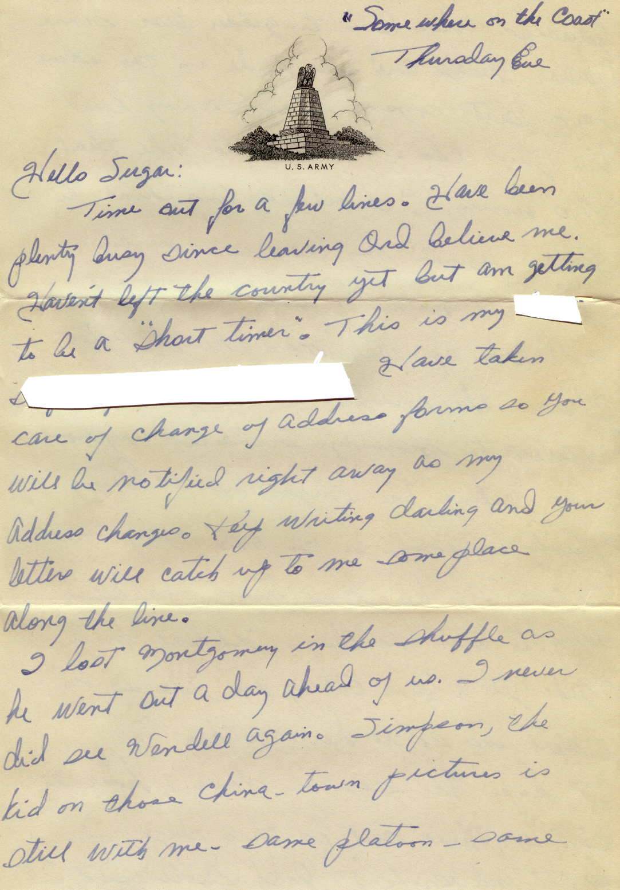
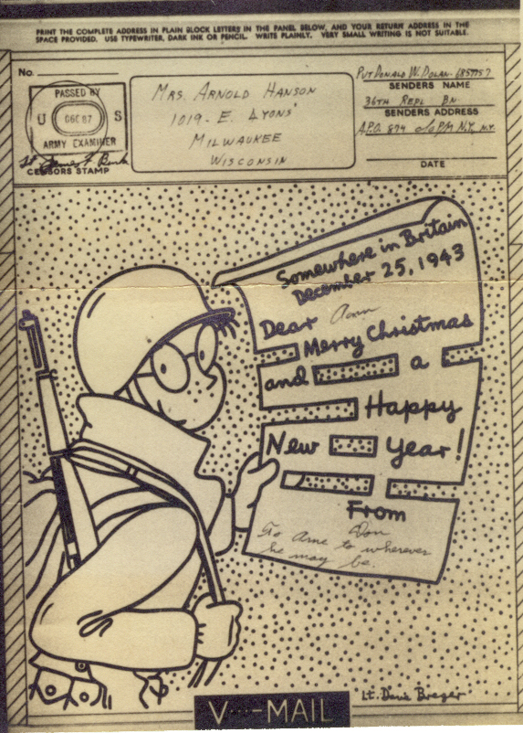
Envelopes full of letters

Slide 57
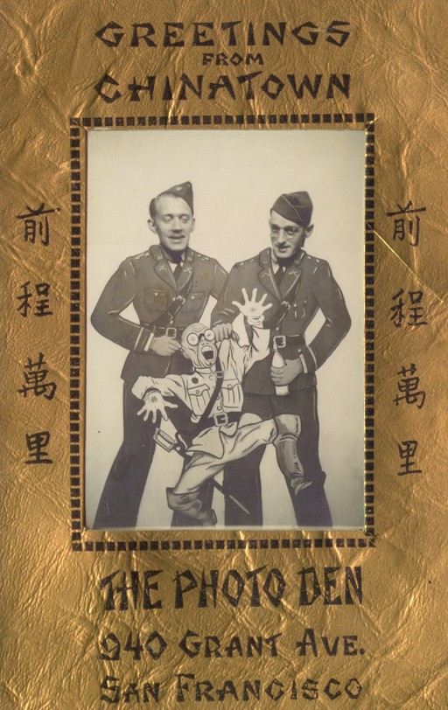
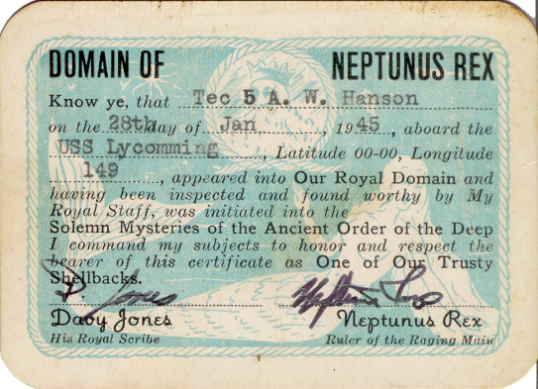
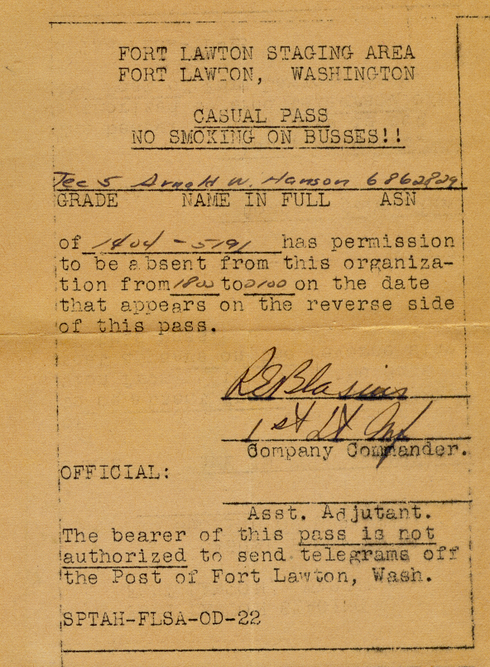
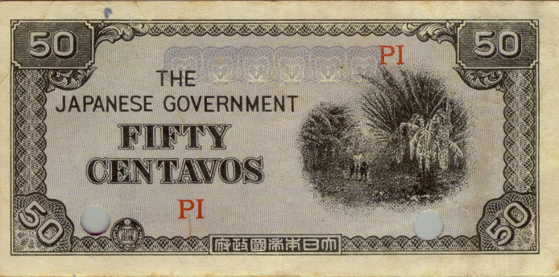
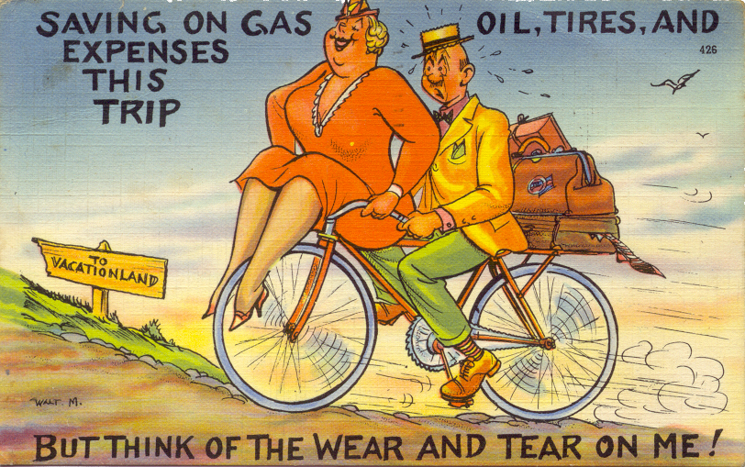





And other items

Slide 58

Stabilization & Labeling
Letters were removed from their envelopes
Envelopes and letters were placed in archive quality plastic sleeves
I sorted them by the date they were written
  I recorded the date and sequence number (if there were multiple letters on the same date) on the sleeve.

Slide 59



Silverfish Damage
Notes:
https://www.hunker.com/13416599/how-to-protect-books-papers-from-silverfish

Slide 60
Digitization
I began scanning the letters, envelopes and other materials in 2001.
  Using the default scanner settings
I was most of the way through scanning them when I realized that I was not using an archive quality file format.
Scanned them again using a “better” file format (jpg)
Uploaded the images to my personal website in 2006
Realized that they really should have been scanned as TIFF files
The project stalled…

Slide 61


Curt Witcher mentioned the Military Heritage Collection at the Allen County Public Library during a seminar in Dallas in 2016

Slide 62


Slide 63
Delivered the letters to the Library in Ft. Wayne in August 2018
  Expected them to be scanned & online “in about a year”
Encountered several delays:
  Installation of a new computer system.
  Need to re-scan the entire collection
  Covid-19 impact

Slide 64



May 3, 2021
(2 ½ Years)
https://genealogycenter.info/military/wwii/search_hansonarnold.php

Slide 65


Slide 66


Slide 67


Slide 68


Slide 69


Slide 70

https://genealogycenter.info/military
Notes:
https://acpl-cms.wise.oclc.org/genealogy -> Our Resources -> Free Databases -> Our Military Heritage
https://www.genealogycenter.info/military/

Slide 71

Case Study #2:
Dallas Genealogical Society Publications
Notes:
I became associated with the DGS in 2010 (when we were both 55 years old) when I agreed to become their webmaster.

Slide 72


I was appointed as Webmaster in 2010

Slide 73

Notes:
I could not “just Google it” because information about most of these documents was not yet posted on the internet

Slide 74






Publications
25 Annual/Semi-annual Journals
88 Quarterlies
348 Newsletters
20+ books
“Born Digital” Documents & Collections

Slide 75


Created an Inventory of published documents
Notes:
This and the next two images are from a presentation I made at the Texas State Genealogical Society Annual Conference in 2012… These things take time!

Slide 76

Notes:
This is an example of the summary page on the DGS web site.

Slide 77
Began Assembling Documents
Our own archives
Some archived at the Dallas Public Library
Many provided by long-term members of the society

Slide 78
Cloud Publishing Methodology
Publish information about the publication.
Index the publication.
Digitize the publication.
Link images to the indexes

Slide 79
Cloud Publishing Methodology
Publish information about the publication.
Index the publication.
Digitize the publication.
Link images to the index.

Slide 80
Notes:
This is an example of the summary page on the DGS web site.

Slide 81


Notes:
While we were working to obtain a complete collection of the documents, we began creating webpages for each one
About 400 individual pages

Slide 82
Cloud Publishing Methodology
Publish information about the publication.
Index the publication.
Digitize the publication.
Link images to the index.

Slide 83


Slide 84


Slide 85

Notes:
This was the only publication that James Gambill appeared in.

Slide 86
Cloud Publishing Methodology
Publish information about the publication.
Index the publication.
Digitize the publication.
Link images to the index.

Slide 87
Digitization
Initiated a multi-year effort to have all Newsletters, Quarterlies and Journals digitized and archived.
Chose the Portal to Texas History as our strategic digitization platform.
Did this in batches as:
  Documents became available
  Funds were obtained

Slide 88

Funding
We paid for some of the work out of our budget.
Funds were raised by participating in North Texas Giving Day events.
Received several “Rescuing Texas History ” mini-grants offered by the University of North Texas Libraries.

Slide 89


Slide 90
Cloud Publishing Methodology
Publish information about the publication.
Index the publication.
Digitize the publication.
Link images to the index.

Slide 92


Slide 94


Slide 95


Slide 96


Slide 97

Notes:
Searching for just “Gambil”
Search for “James Gambil” found only on document

Slide 99


Slide 100



Slide 101
Cloud Publishing Methodology
Publish information about the publication.
Index the publication.
Digitize the publication.
Link images to the index.

Slide 102
Cloud Publishing Methodology
Publish information about the publication.
Index the publication.
Digitize the publication.
Link images to the index.
Reimagine/Reuse the digital images
A New Step!

Slide 103


Slide 104


Slide 105


Slide 106


Notes:
First published in 1966, last group published in 1985
And we created an index of names referenced on each page.

Slide 107



Slide 108


Slide 109




Cemetery Publications
Notes:
First (of 5) books published in 1982

Slide 110

Information on more than 42,000 burials
Focus: Older, historical cemeteries
Does NOT include records from contemporary perpetual care cemeteries
Notes:
Sparkman/Hilcrest
Restland

Slide 111


Slide 112



Slide 113


Slide 114
Cloud Publishing Methodology
Publish information about each publication
Index each publication
Digitize the publications
Link images to index entries
Reimagine & Reuse the images

Slide 115
“The two most powerful warriors are patience and time”
Leo Tolstoy

Slide 116
Thank you!

Slide 117
Questions?

Slide 118
Tony Hanson
Email: aehanson@swbell.net
Website: https://www.rayson.us/aehanson/

Slide 119

Notes:
TIPS – 1) Register with TxSGS 2) Have your members register with your society code (Provided by TxSGS) 3) Get $10 for every registration for a Standard or All in One registration.
Also: Please participate as an exhibitor! $75 ($50 if you participate in the TIPS program)

